Slide 1
Samuel Field Y Adult Center A Look At The Haggadah
Illustrated Haggadot
Presented by Abe Katz, Founding Director, The Beurei Hatefila Institute
www.beureihatefila.com

Slide 2
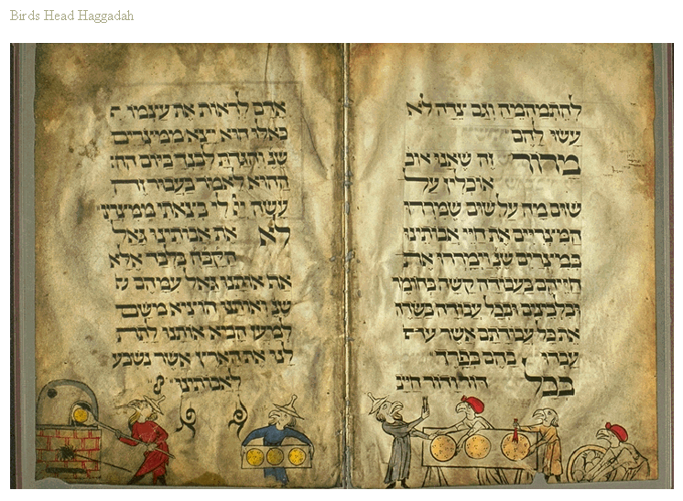
Samuel Field Y Adult Center A Look At The Haggadah
Bird’s Head Haggadah-Germany 1300’s

Slide 3
Samuel Field Y Adult Center A Look At The Haggadah
Is There A Genre Of Art That Can Be Called
“Jewish Art”?
The Discovery Of The Synagogue At
Dura Europos, Syria
Circa 200 CE

Slide 4
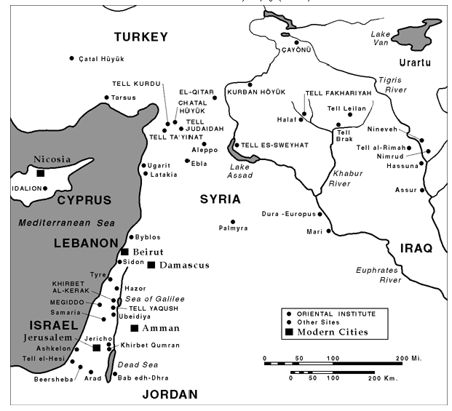
Samuel Field Y Adult Center A Look At The Haggadah
Map Locating Dura Europos-200 C.E.

Slide 5
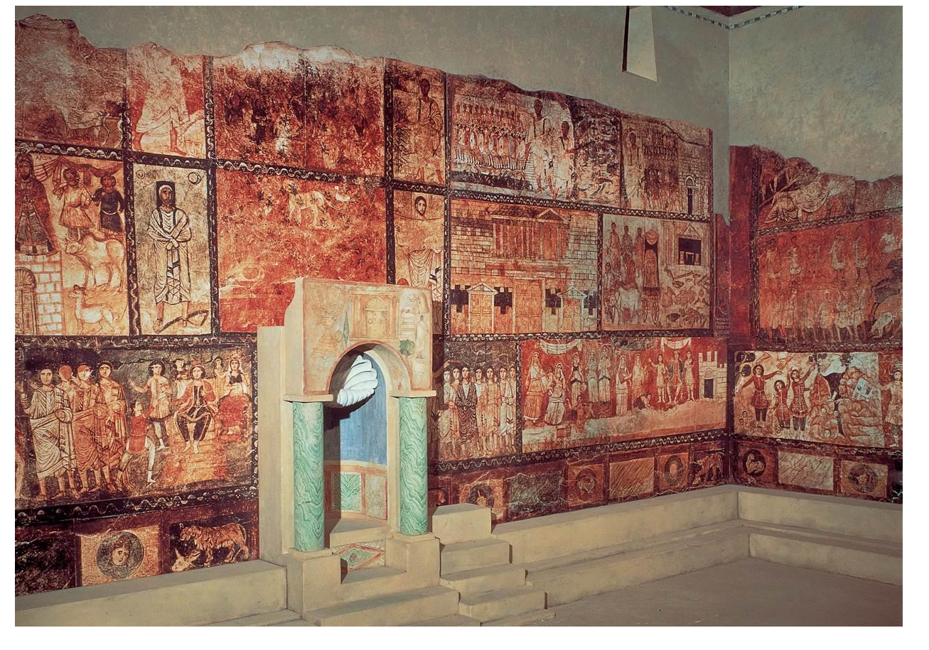
Samuel Field Y Adult Center A Look At The Haggadah
Picture Of Interior Of Synagogue At Dura Europos

Slide 6
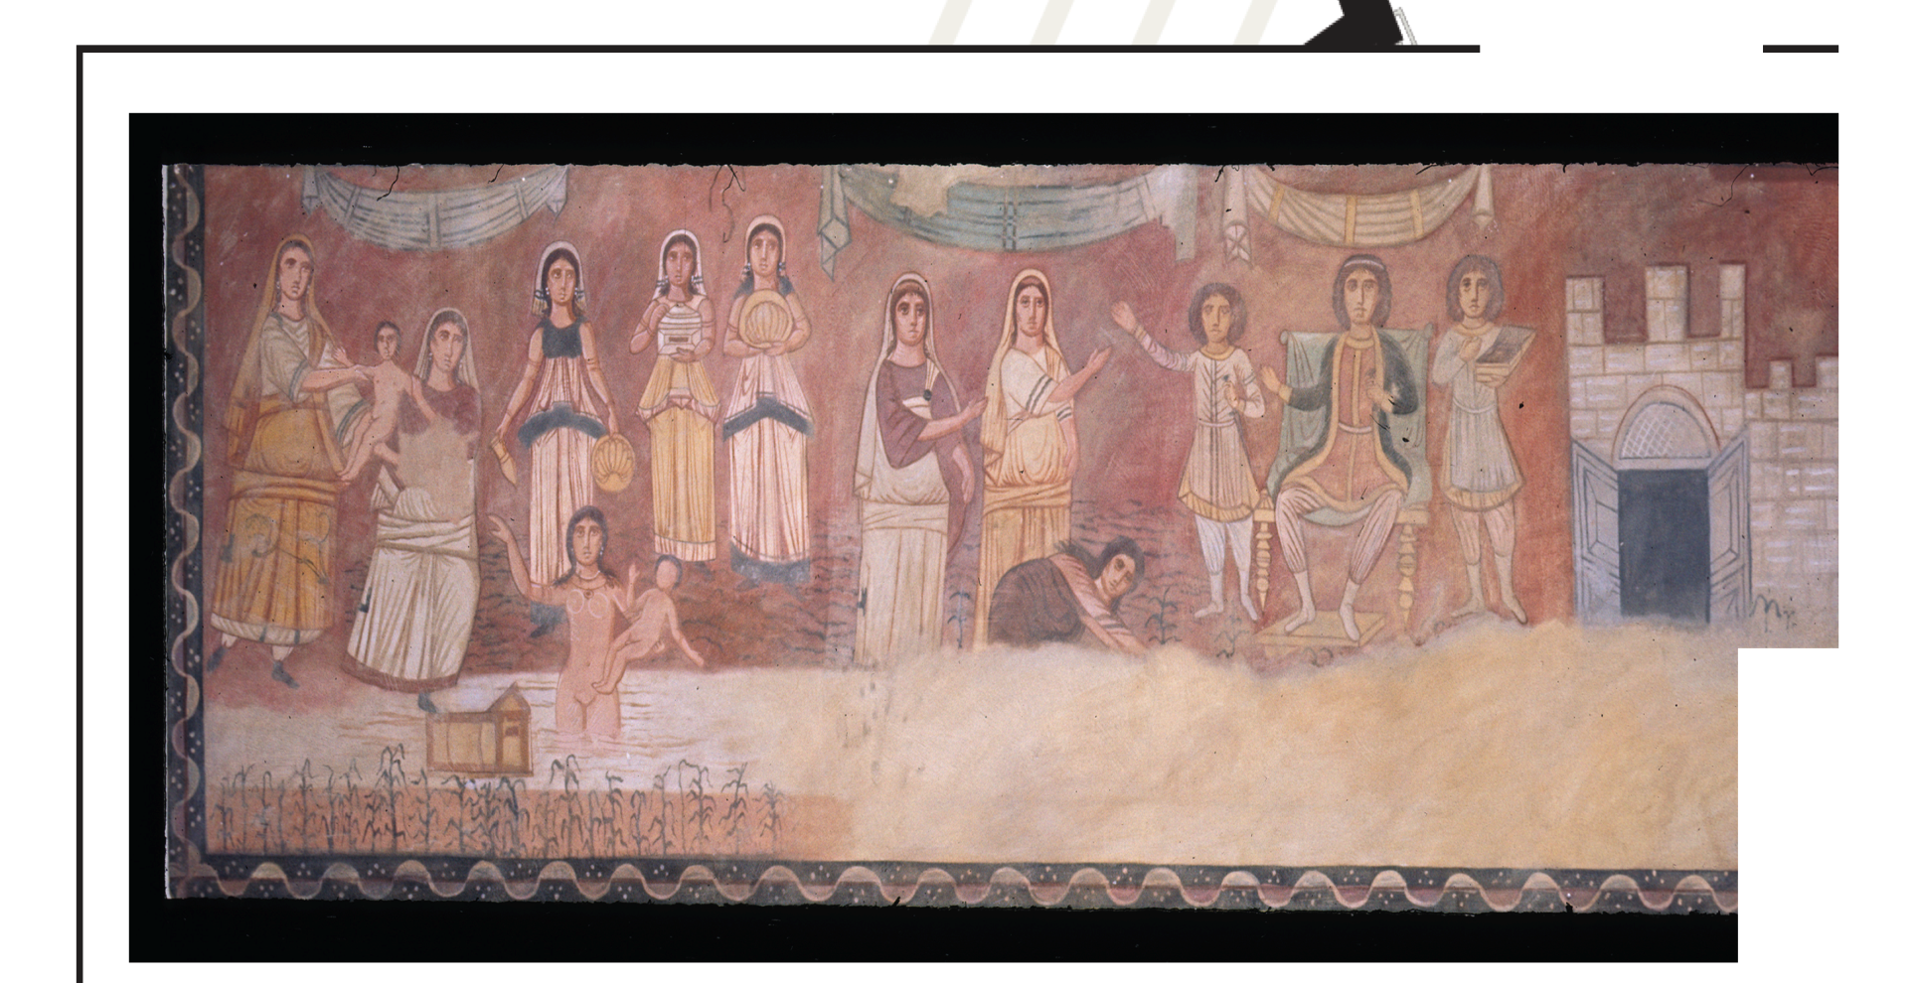
Samuel Field Y Adult Center A Look At The Haggadah
Sample Fresco From The Synagogue At Dura Europos

Slide 7
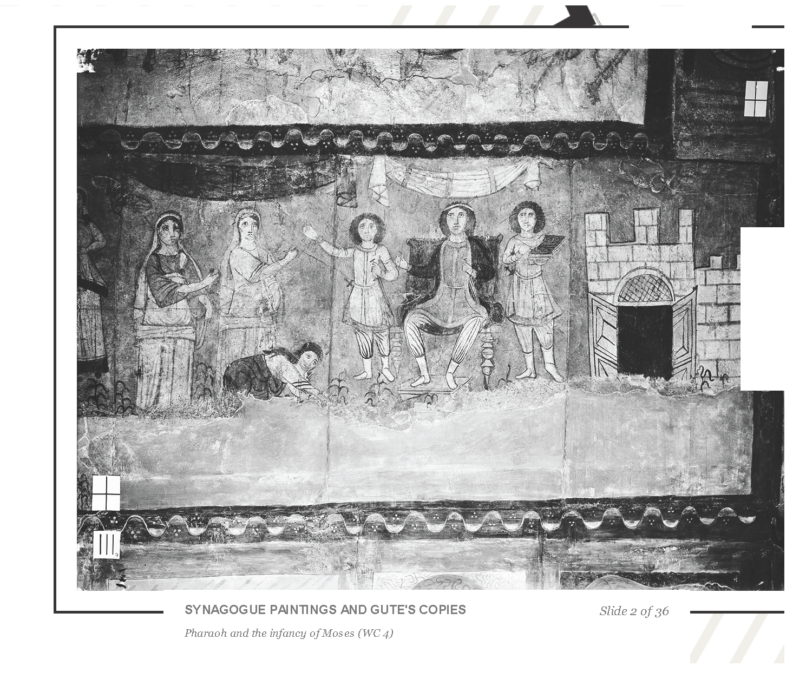
Samuel Field Y Adult Center A Look At The Haggadah
.
Sample Fresco From The Synagogue At Dura Europos

Slide 8
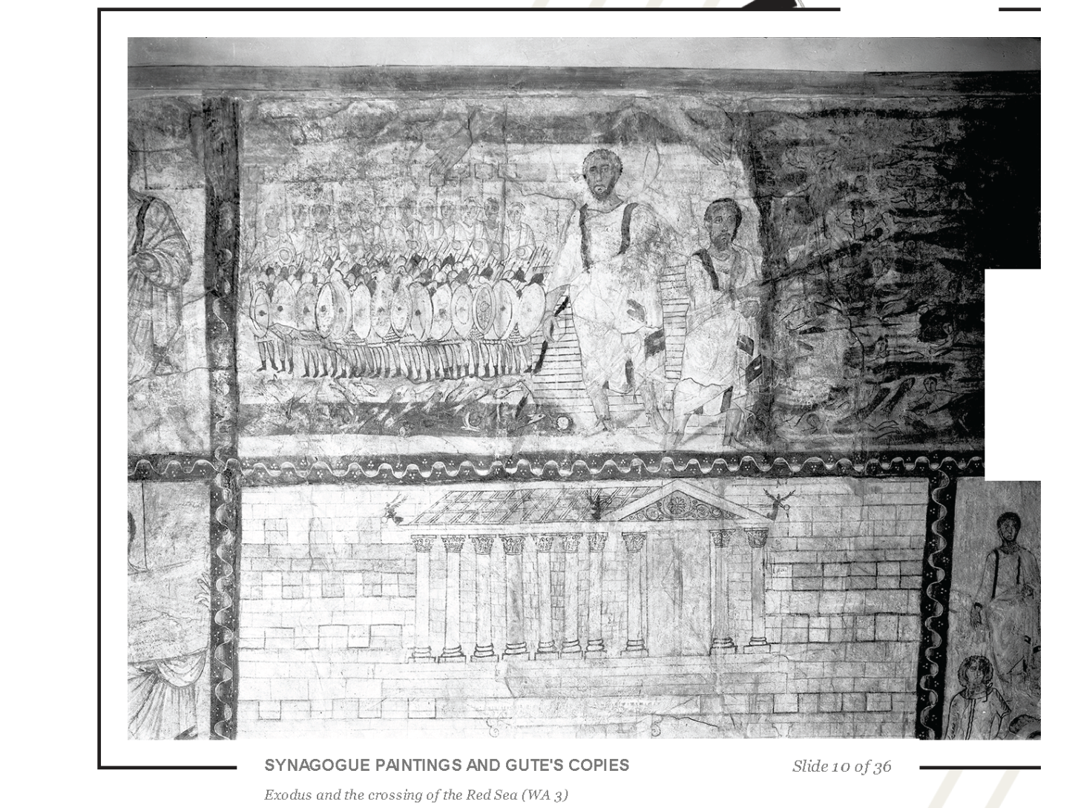
Samuel Field Y Adult Center A Look At The Haggadah
Sample Fresco From The Synagogue At Dura Europos

Slide 9
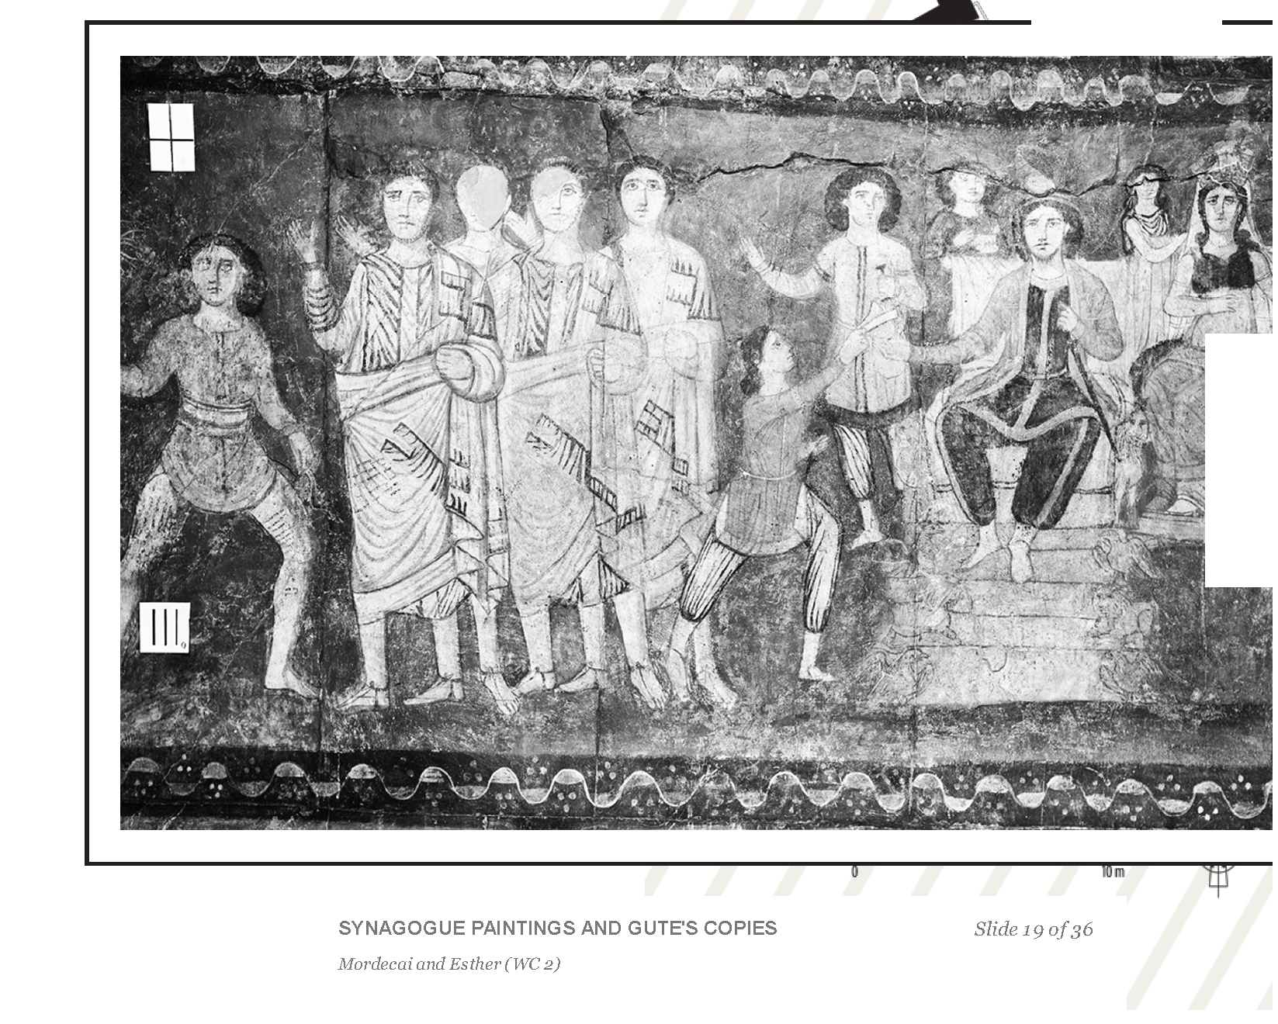
Samuel Field Y Adult Center A Look At The Haggadah
Sample Fresco From The Synagogue At Dura Europos

Slide 10
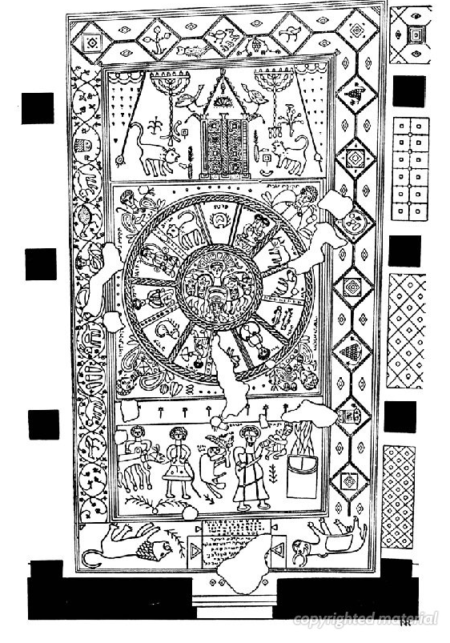
Samuel Field Y Adult Center A Look At The Haggadah
Mosaic Floor Beth Alpha Synagogue 600 CE

Slide 11
Samuel Field Y Adult Center A Look At The Haggadah
Examples Of Illustrations
In Handwritten Manuscript Haggadot
Beginning In The 1300’s

Slide 12
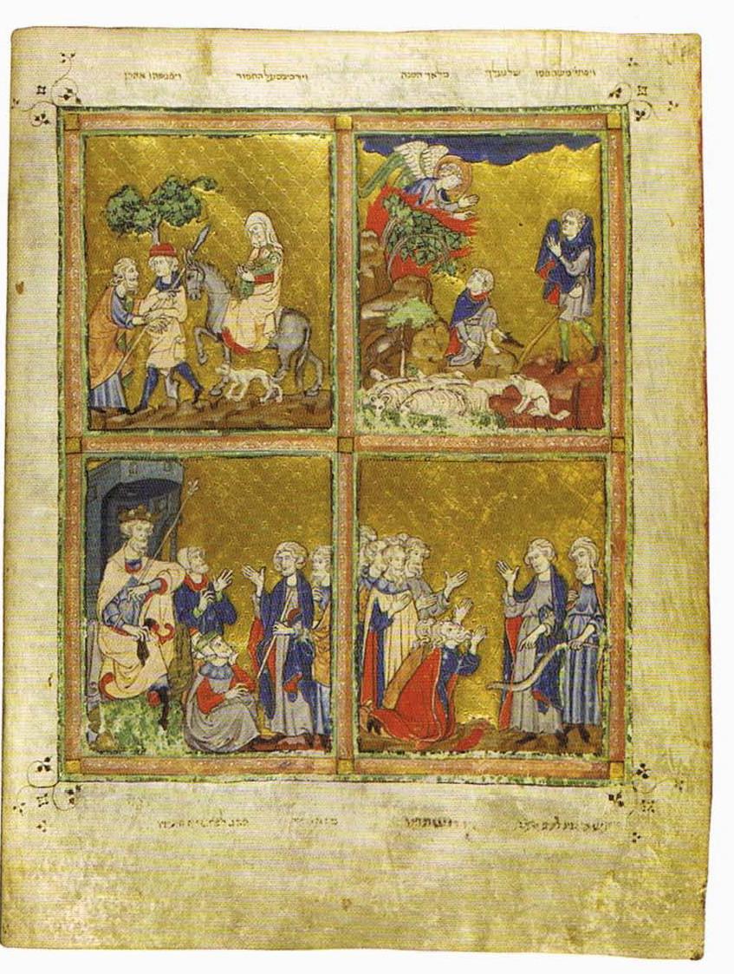
Samuel Field Y Adult Center A Look At The Haggadah
Golden Haggadah-Spain 1300’s

Slide 13
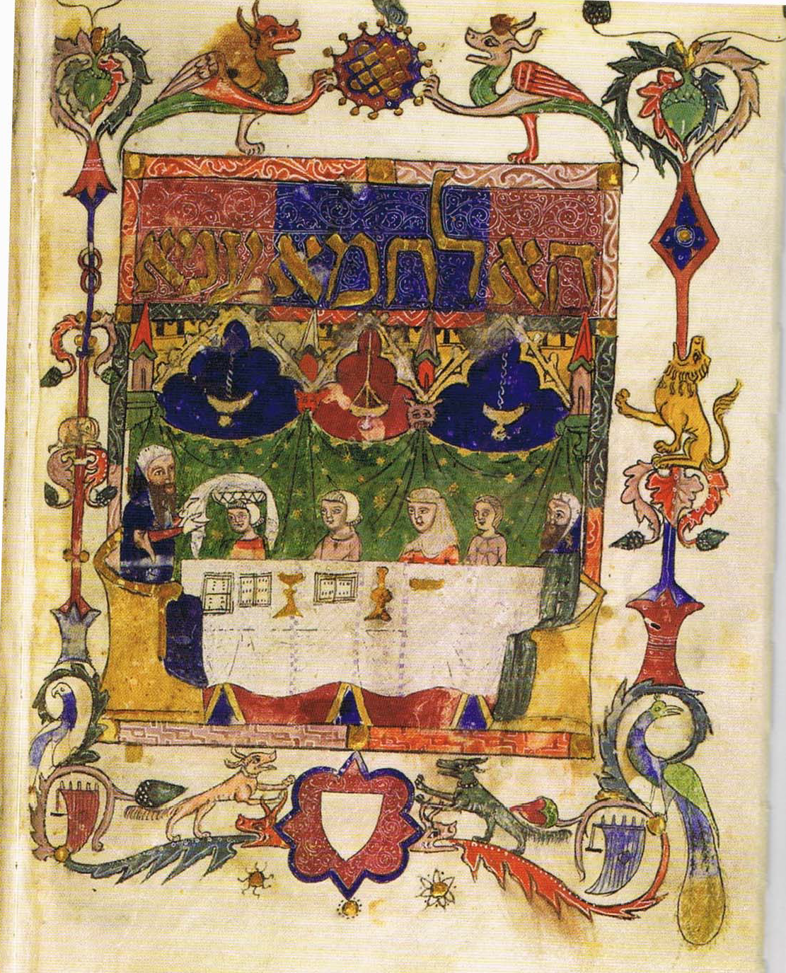
Samuel Field Y Adult Center A Look At The Haggadah
Castile Spain 1300’s

Slide 14
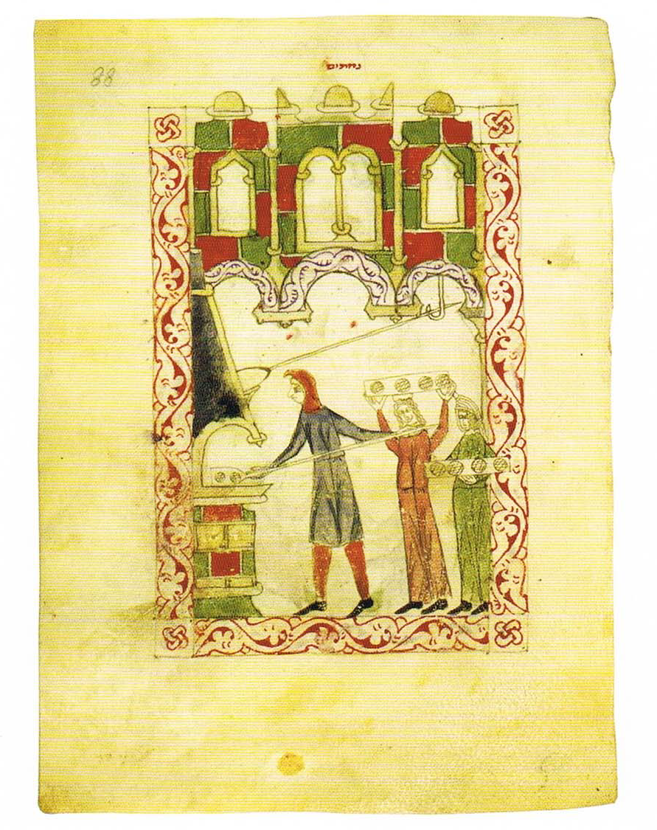
Samuel Field Y Adult Center A Look At The Haggadah
Castile 1300

Slide 15
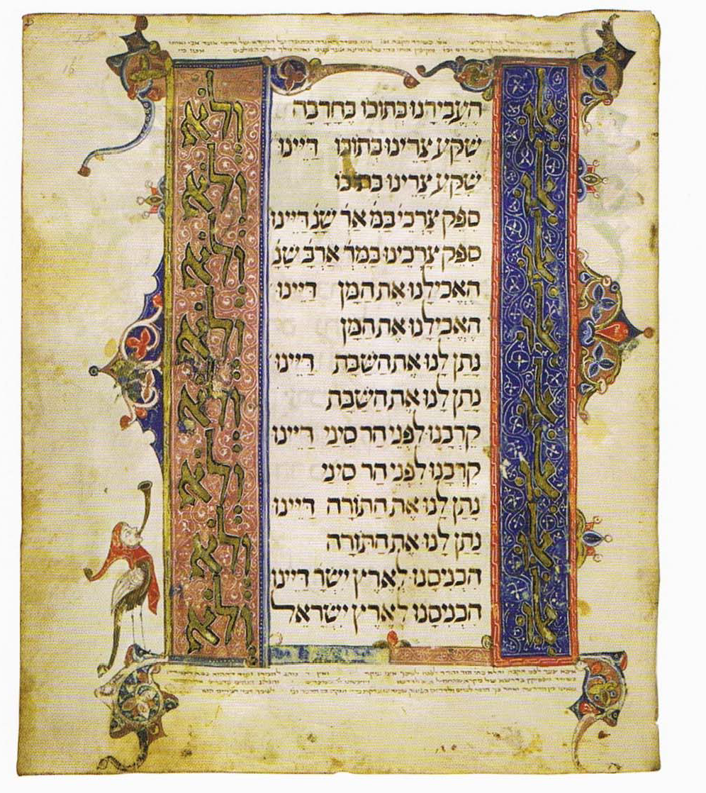
Samuel Field Y Adult Center A Look At The Haggadah
Brother Haggadah Catalonia 1350-1375

Slide 16
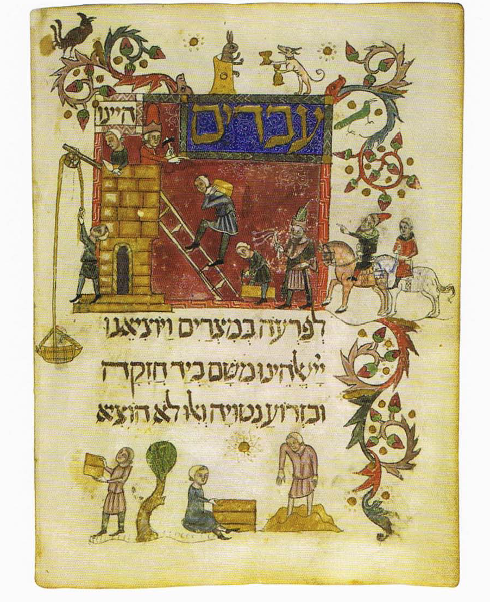
Samuel Field Y Adult Center A Look At The Haggadah
Catalonia 1370

Slide 17
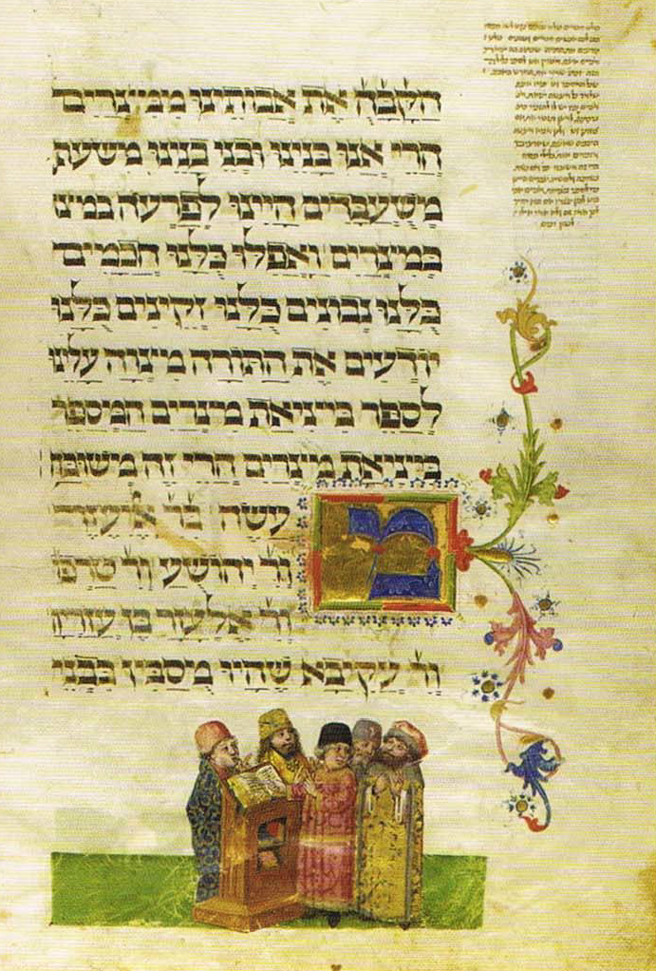
Samuel Field Y Adult Center A Look At The Haggadah
Ashkenaz 1470

Slide 18
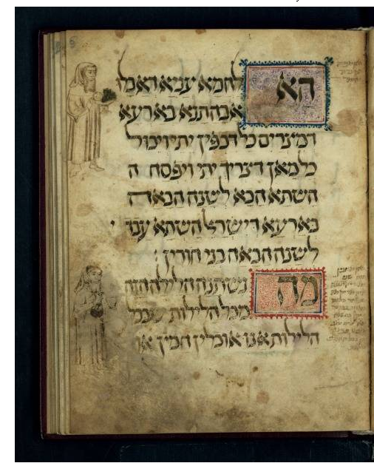
Samuel Field Y Adult Center A Look At The Haggadah
Wolf Haggadah Ashkenaz 14th Century

Slide 19
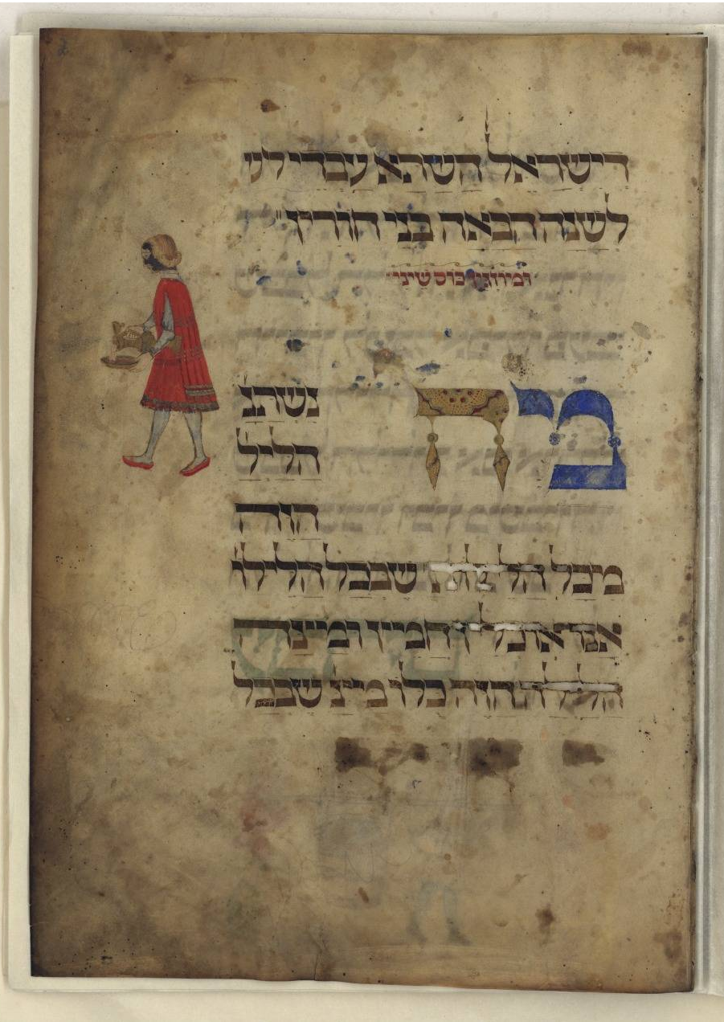
Samuel Field Y Adult Center A Look At The Haggadah
Rothschild Haggadah Northern Italy 1479

Slide 20
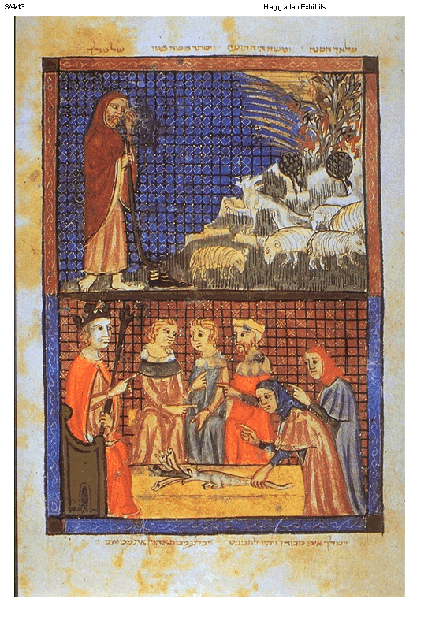
Samuel Field Y Adult Center A Look At The Haggadah
Sarajevo Haggadah Spain 14th Century

Slide 21
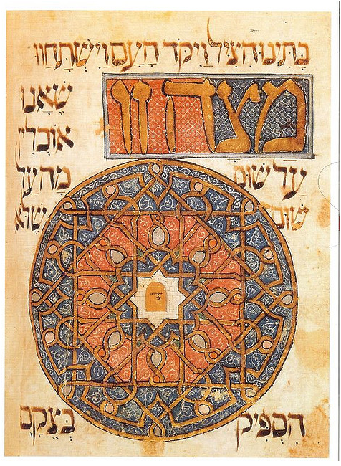
Samuel Field Y Adult Center A Look At The Haggadah
Catalonia 1320

Slide 22
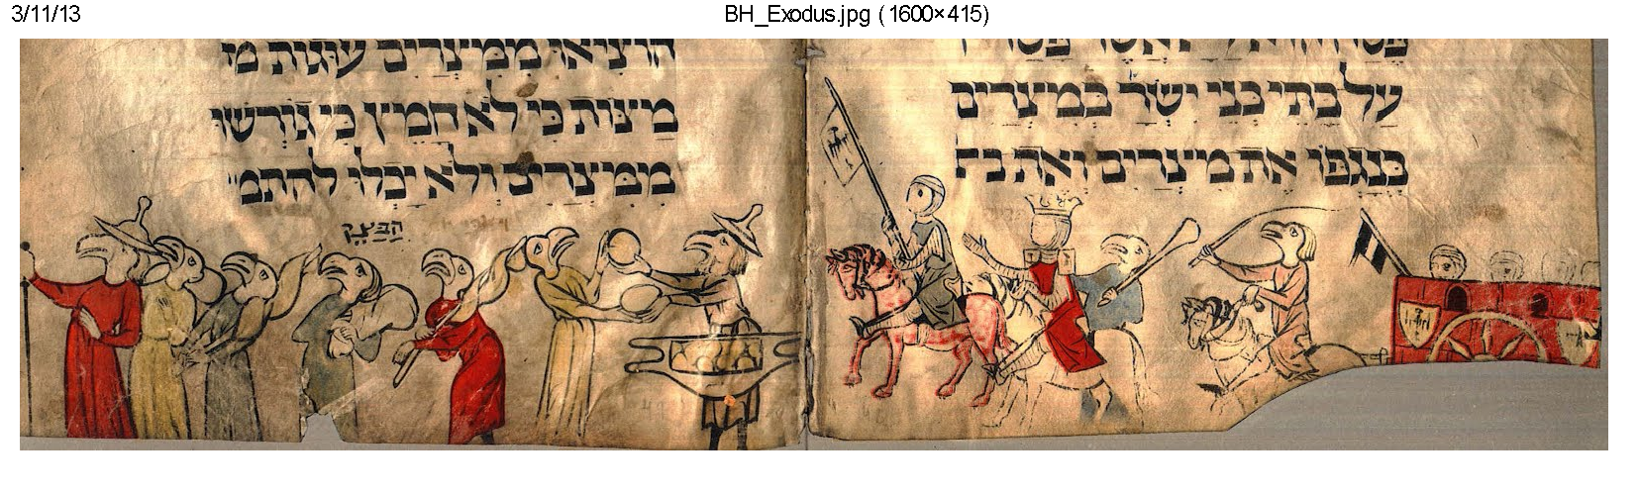
Samuel Field Y Adult Center A Look At The Haggadah
Bird’s Head Ashkenazic Thirteenth Century

Slide 23
Samuel Field Y Adult Center A Look At The Haggadah
Illustrations In Printed Haggadot

Slide 24
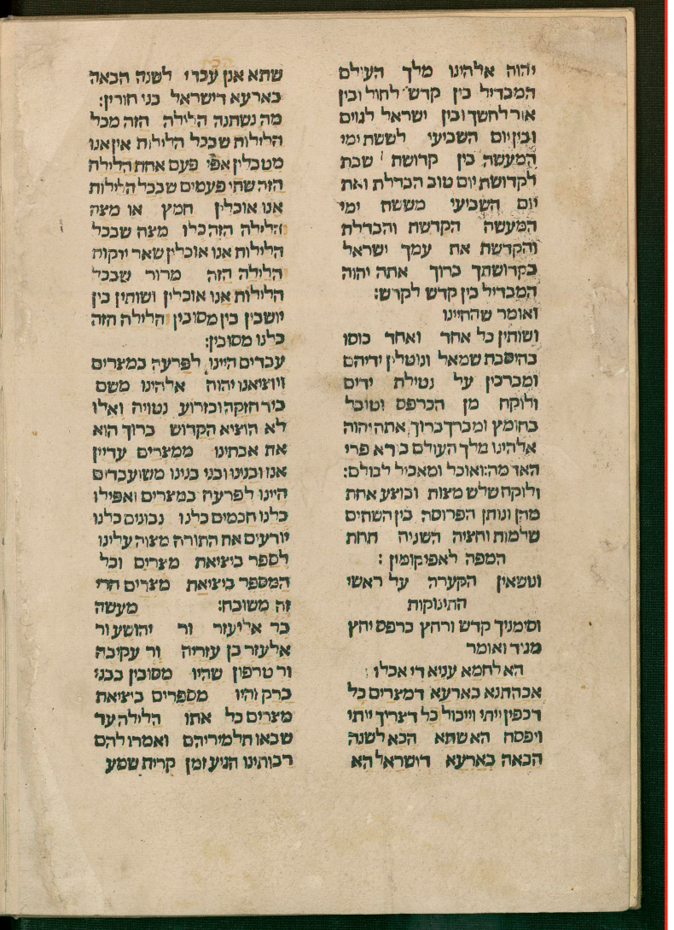
Samuel Field Y Adult Center A Look At The Haggadah
First Printed Haggadah-Guadalajara, Spain 1482

Slide 25
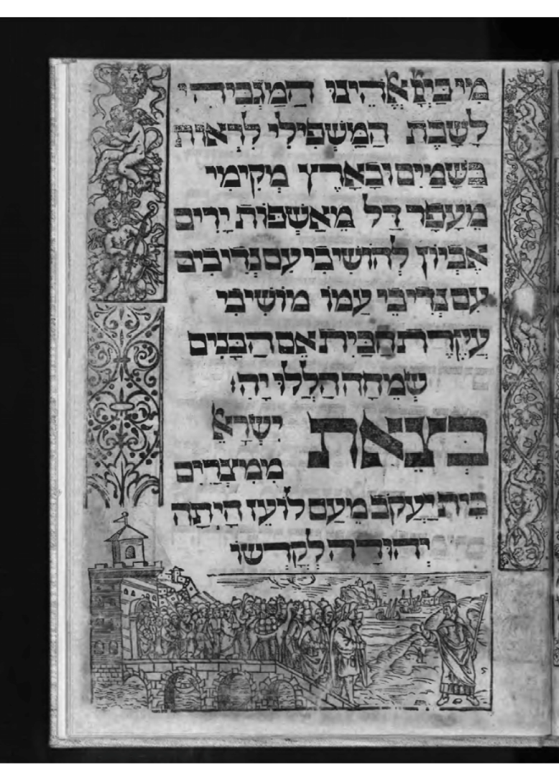
Samuel Field Y Adult Center A Look At The Haggadah
Mantua, Italy 1560

Slide 26
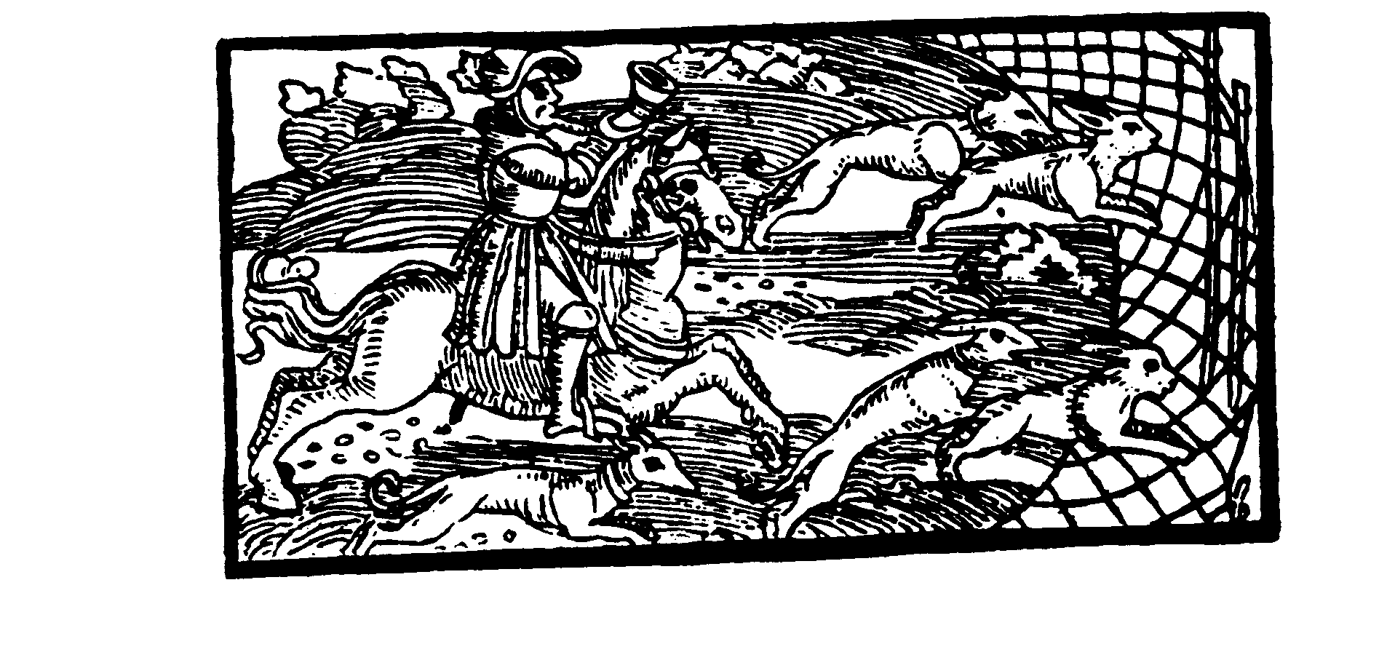
Samuel Field Y Adult Center A Look At The Haggadah
Prague 1526

Slide 27
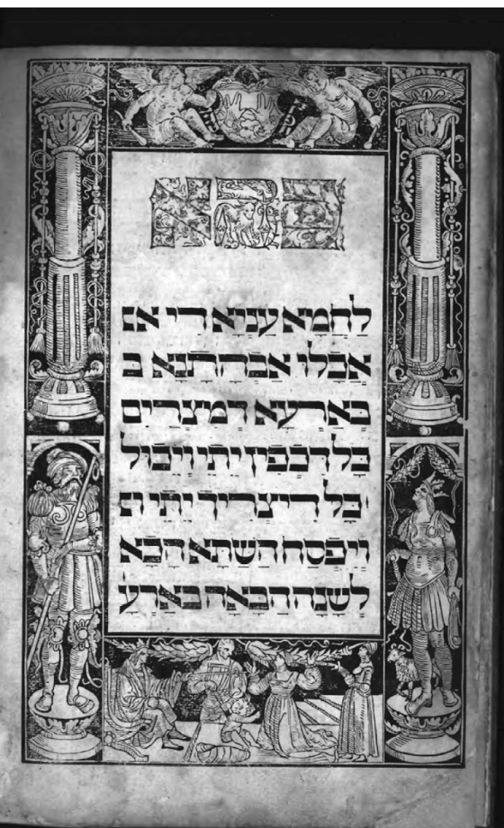
Samuel Field Y Adult Center A Look At The Haggadah
Prague 1593

Slide 28
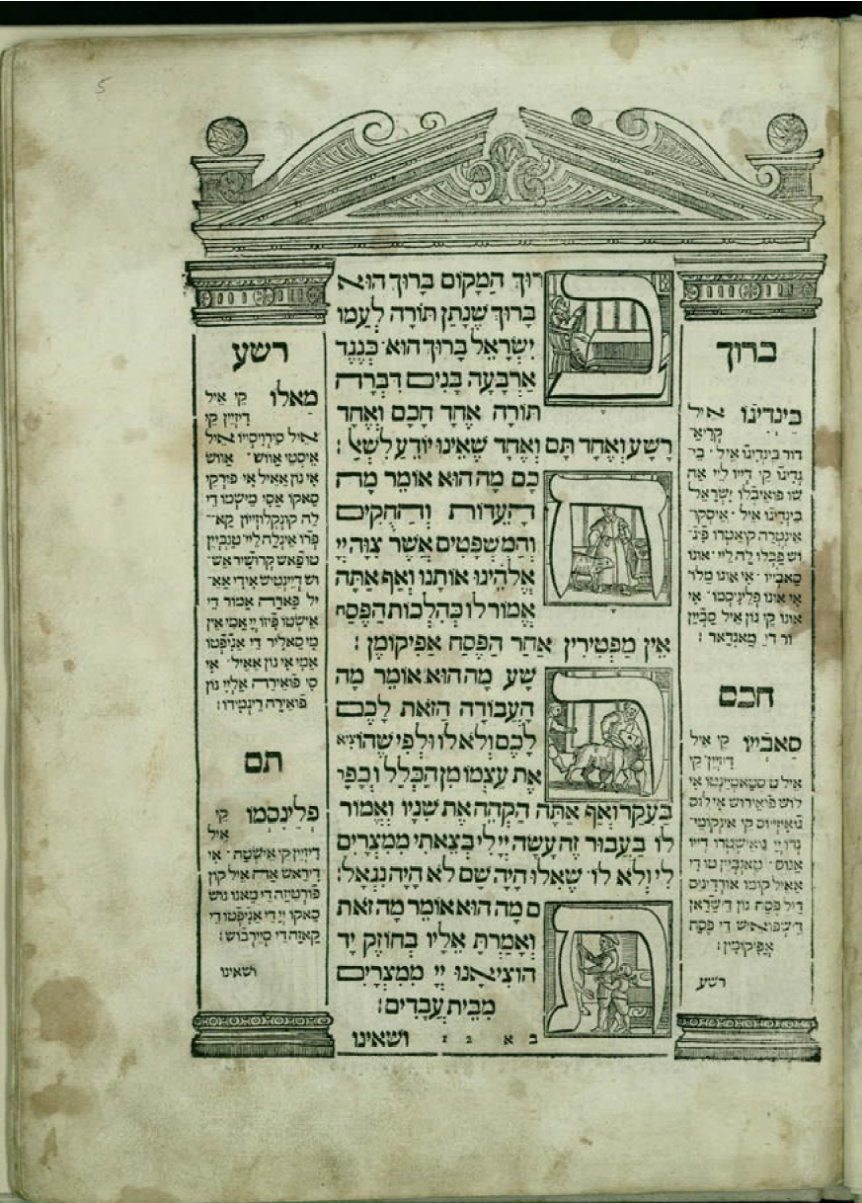
Samuel Field Y Adult Center A Look At The Haggadah
Venice 1609

Slide 29
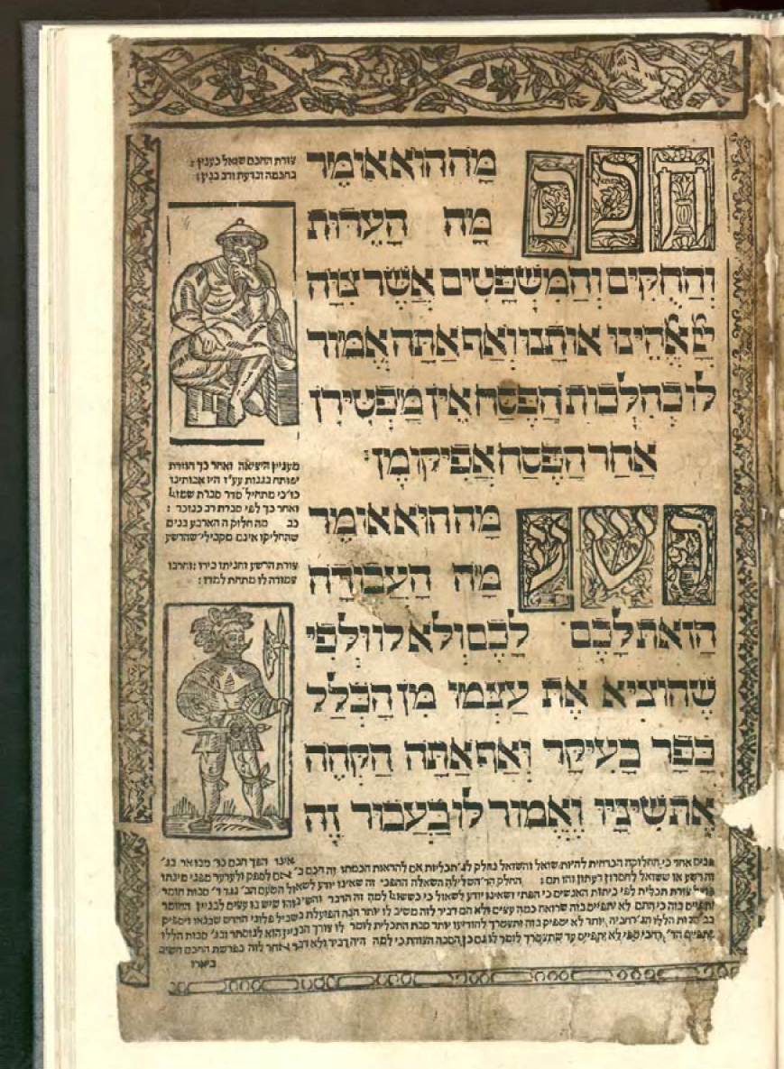
Samuel Field Y Adult Center A Look At The Haggadah
Lublin 1619

Slide 30
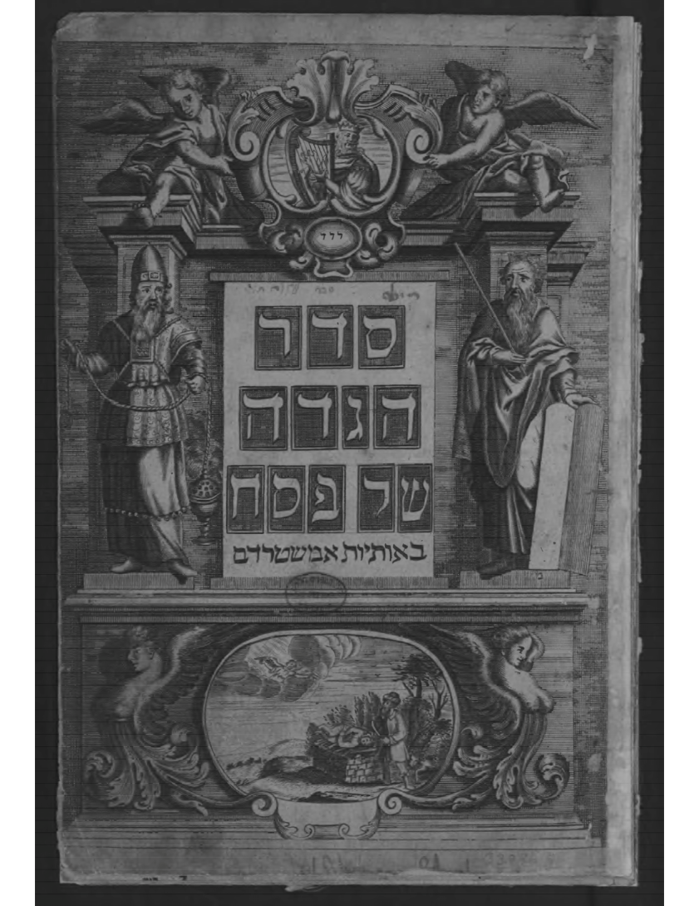
Samuel Field Y Adult Center A Look At The Haggadah
Title Page Amsterdam-1729

Slide 31
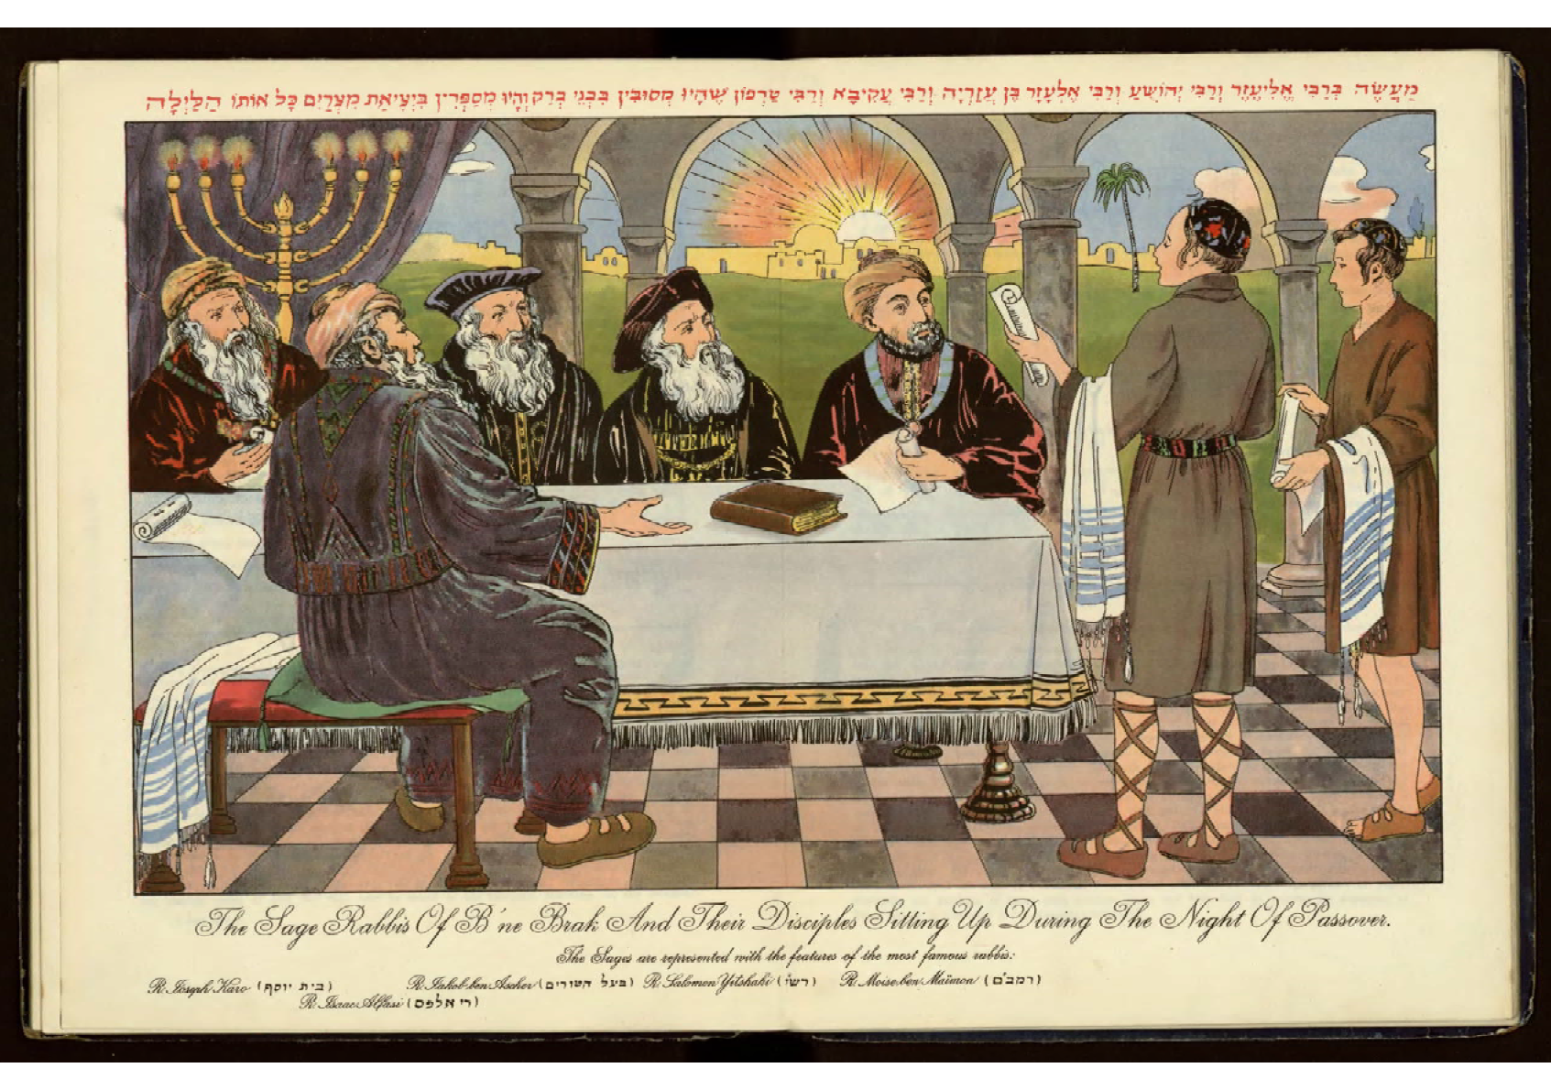
Samuel Field Y Adult Center A Look At The Haggadah
Vienna -1933-The Rabbis Studying

Slide 32
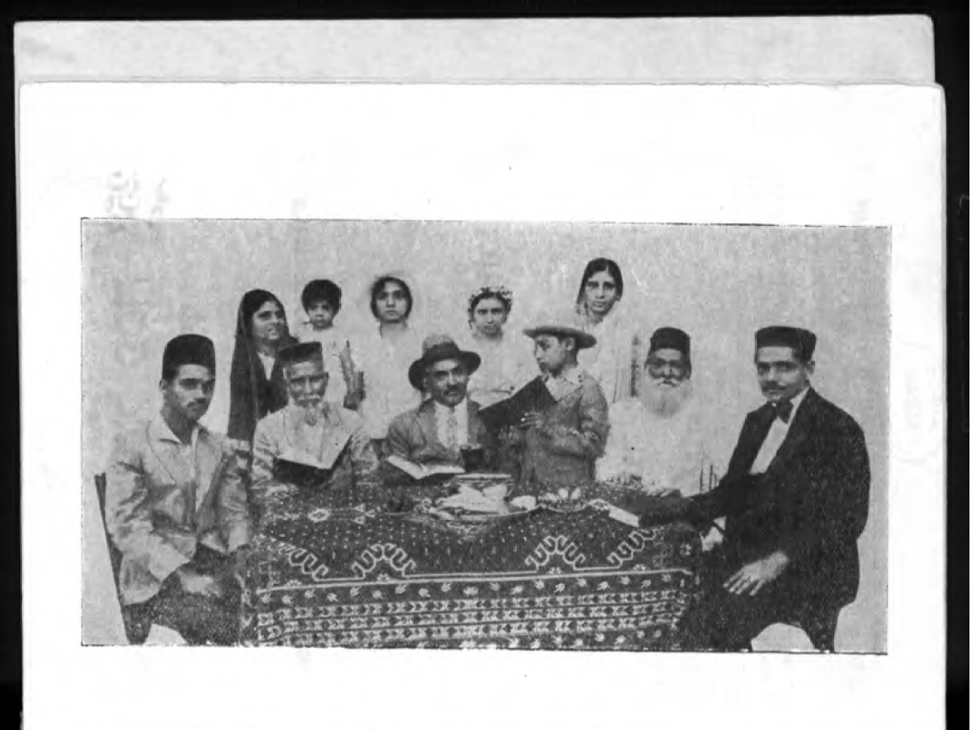
Samuel Field Y Adult Center A Look At The Haggadah
Bombay Haggadah 1935

Slide 33
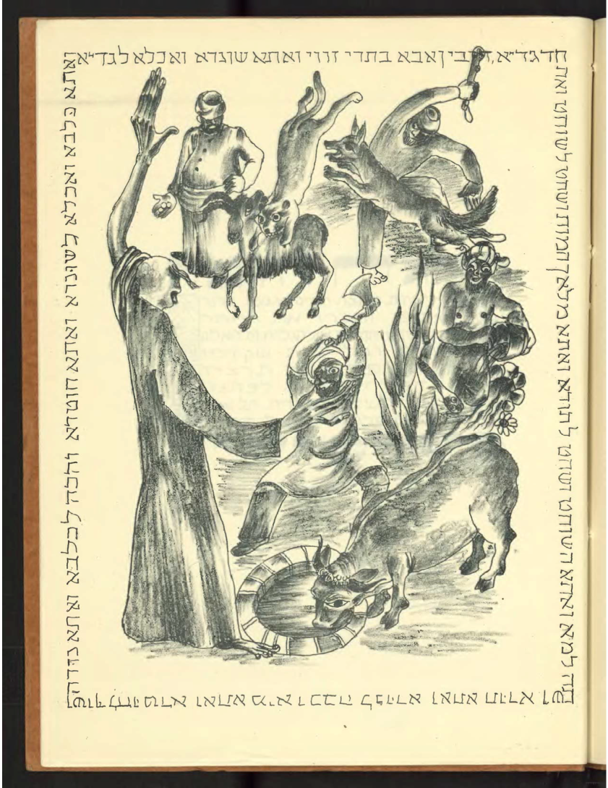
Samuel Field Y Adult Center A Look At The Haggadah
Chad Gadya-Israel 1937

Slide 34
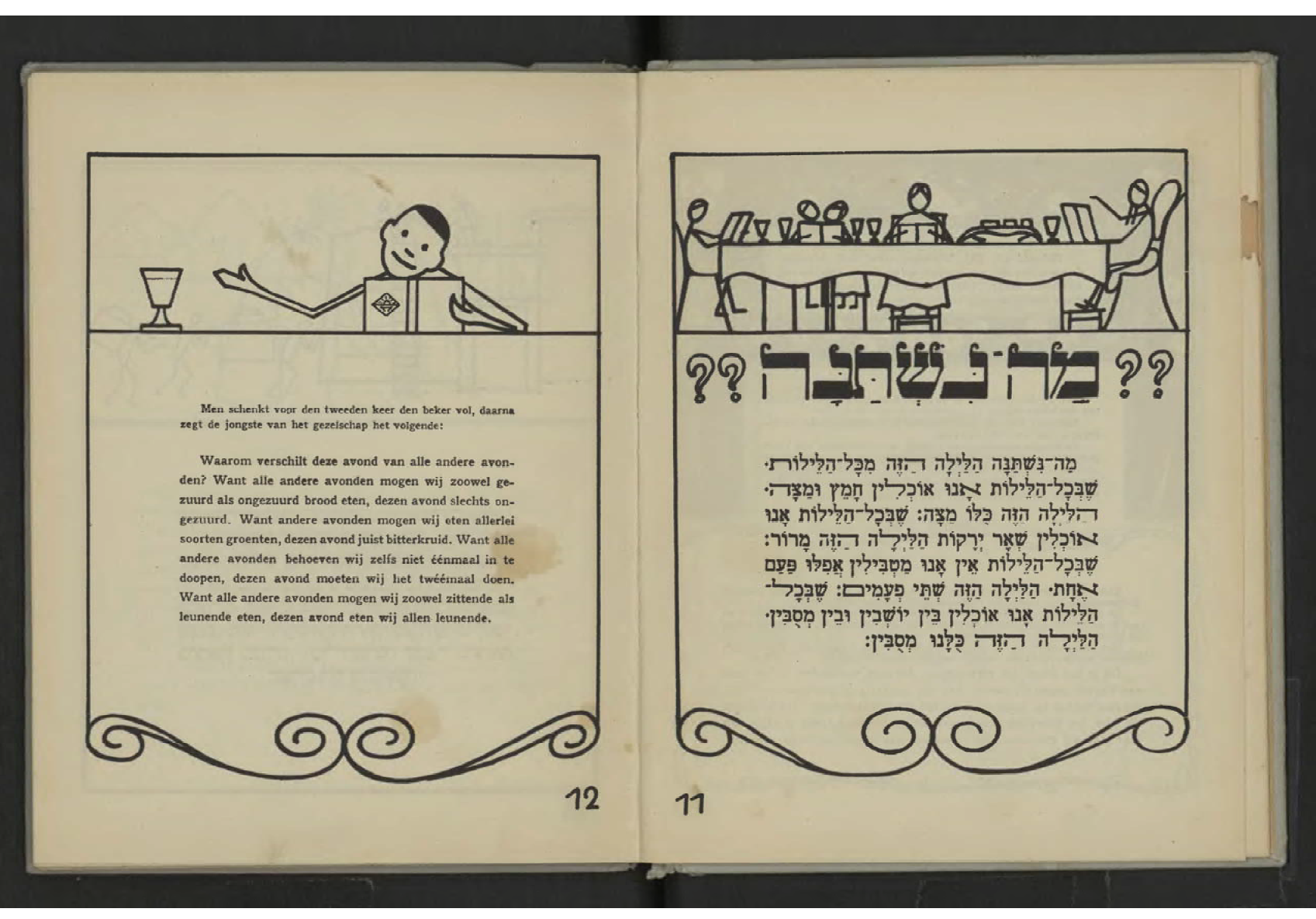
Samuel Field Y Adult Center A Look At The Haggadah
Netherlands-1943

Slide 35
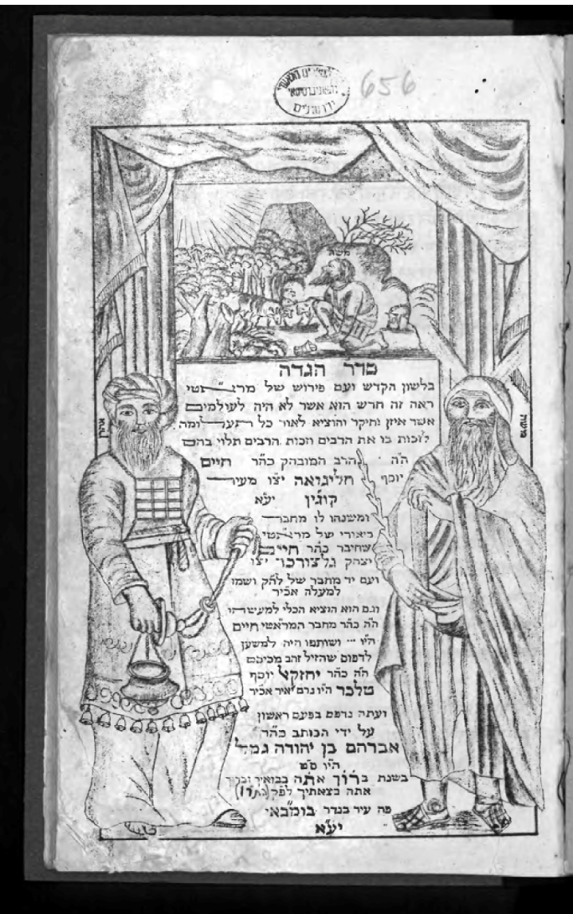
Samuel Field Y Adult Center A Look At The Haggadah
Mumbai, India 1946

Slide 36
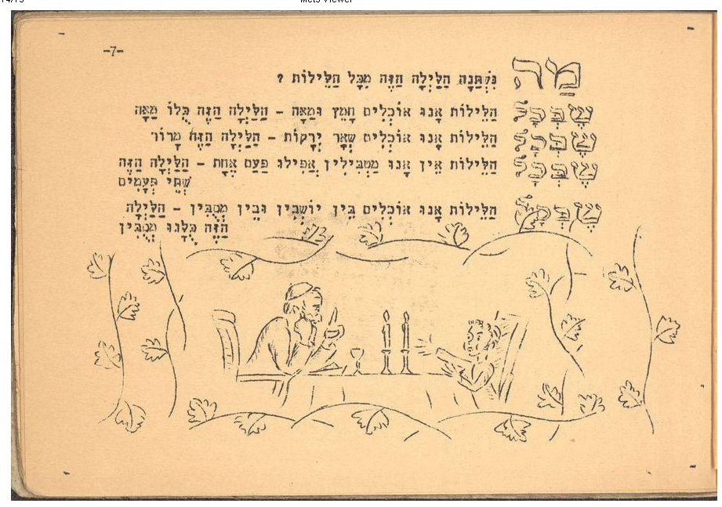
Samuel Field Y Adult Center A Look At The Haggadah
Palmach, Branch Of Israeli Army, 1948

Slide 37
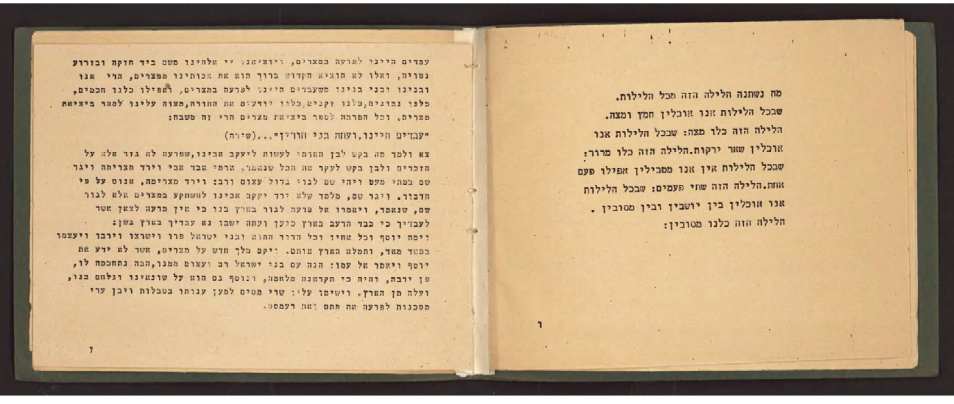
Samuel Field Y Adult Center A Look At The Haggadah
Haggadah For Soldiers From Israel Fighting For England In WWII

Slide 38
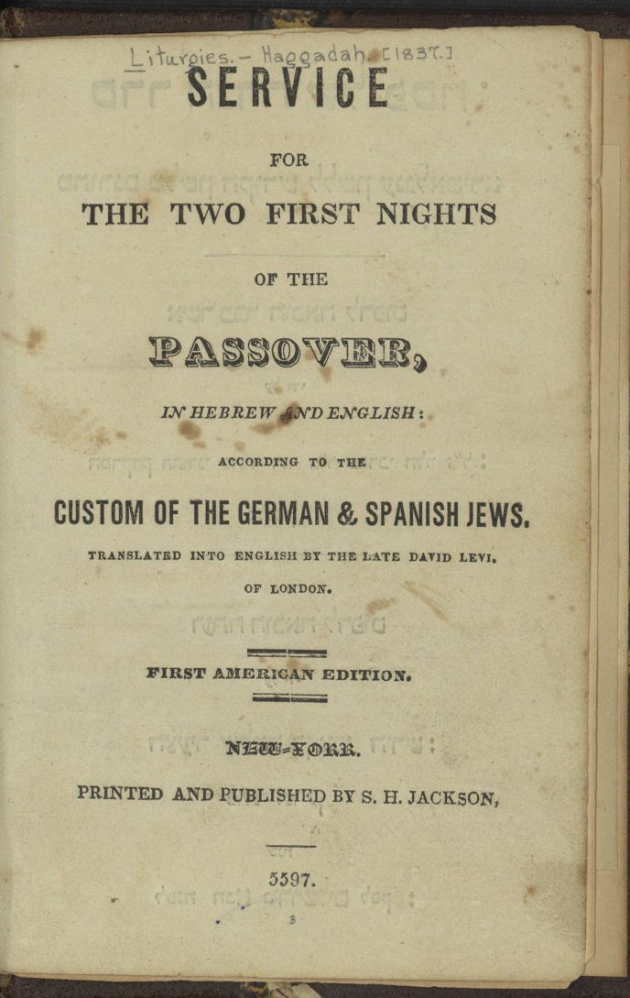
Samuel Field Y Adult Center A Look At The Haggadah
First Haggadah Printed In The United States

Slide 39
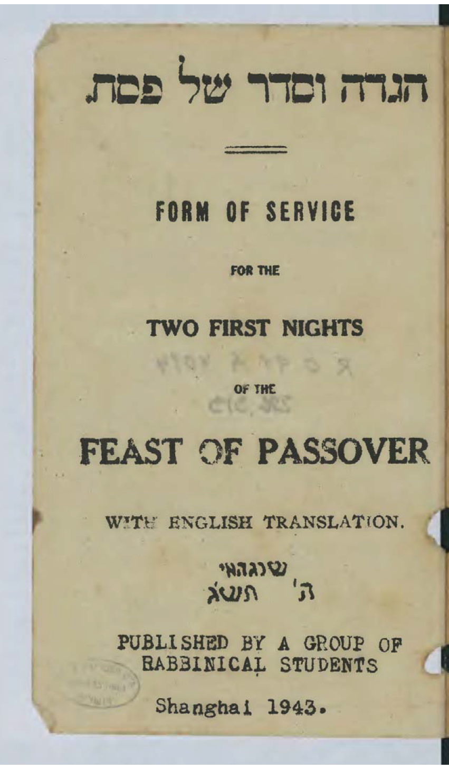
Samuel Field Y Adult Center A Look At The Haggadah
Shanghai Haggadah 1943

Slide 40

Samuel Field Y Adult Center A Look At The Haggadah
Haggadah For Holocaust Survivors In DP Camps

Slide 41
Samuel Field Y Adult Center A Look At The Haggadah
Illustrations Of The Four Sons Over The Years

Slide 42
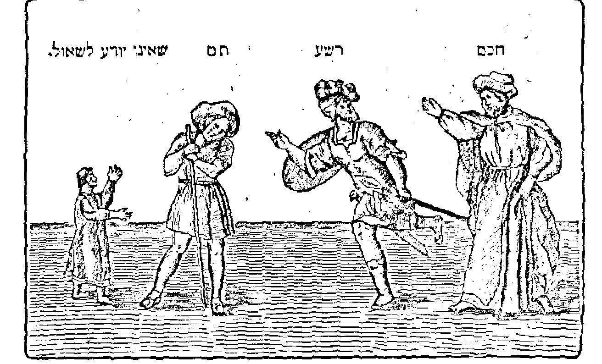
Samuel Field Y Adult Center A Look At The Haggadah
Prague 1526

Slide 43
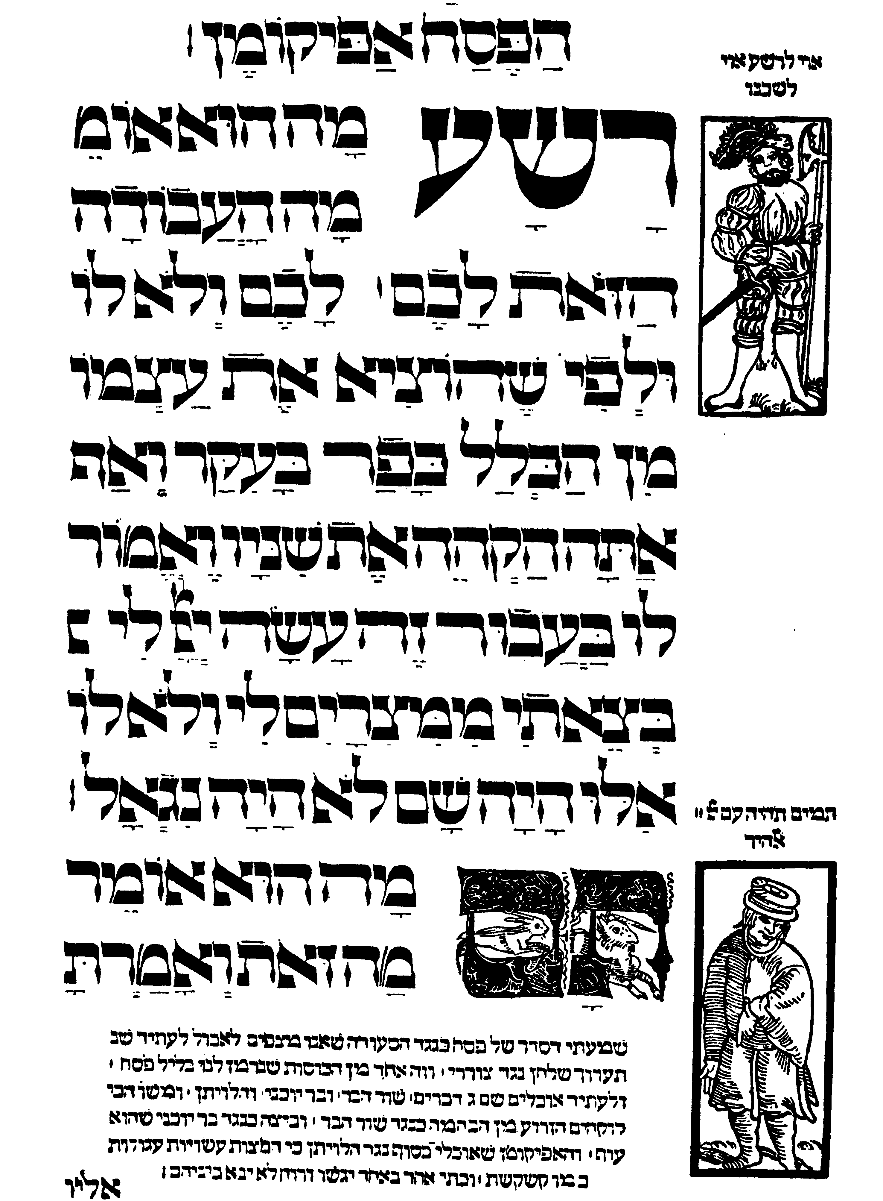
Samuel Field Y Adult Center A Look At The Haggadah
Prague 1526

Slide 44
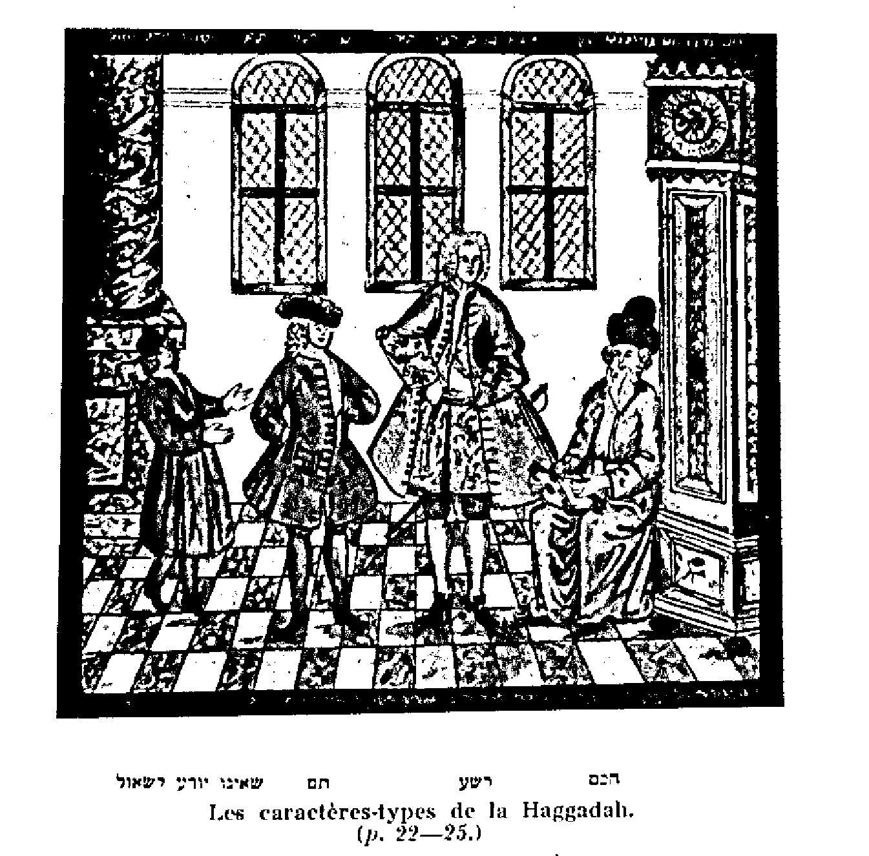
Samuel Field Y Adult Center A Look At The Haggadah
France 1880’s

Slide 45
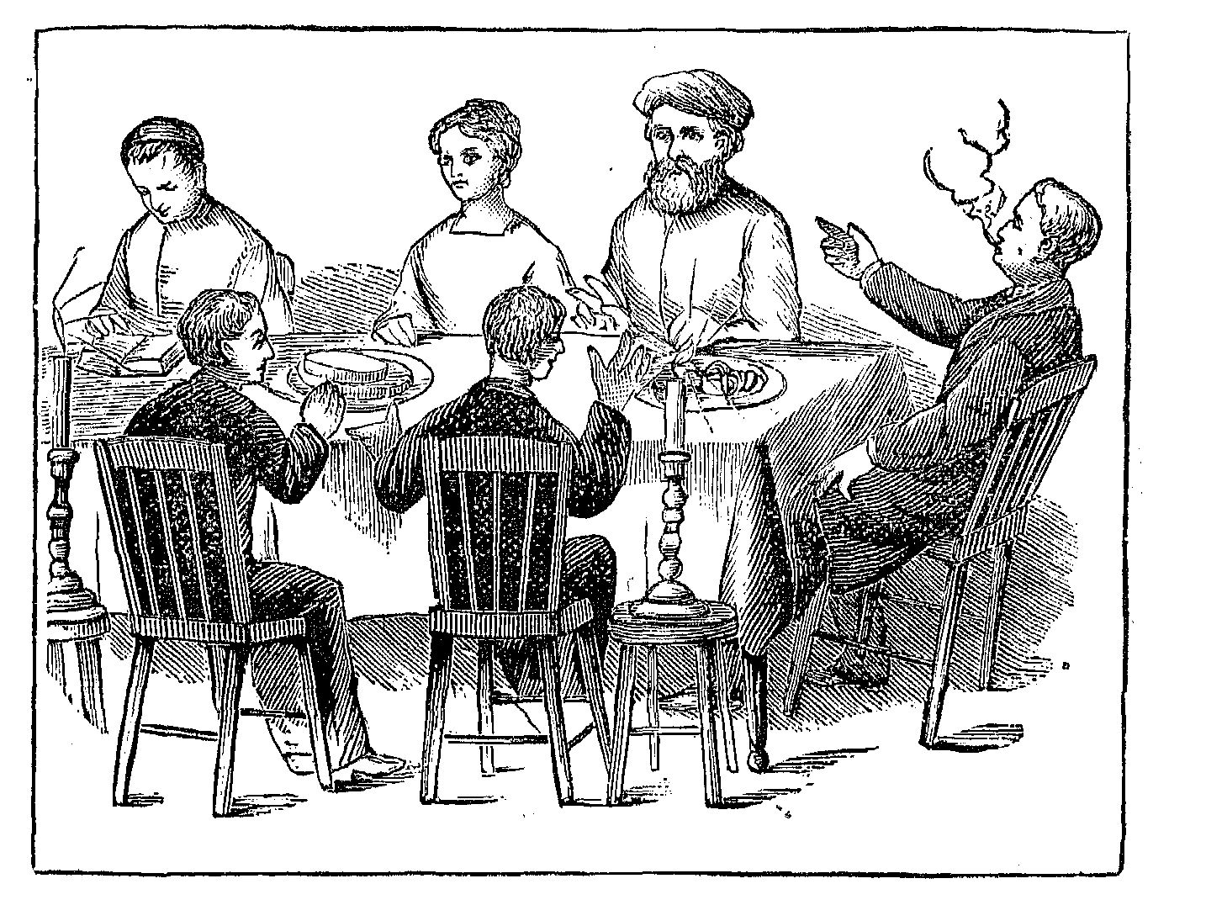
Samuel Field Y Adult Center A Look At The Haggadah
American 1879 Four Sons

Slide 46
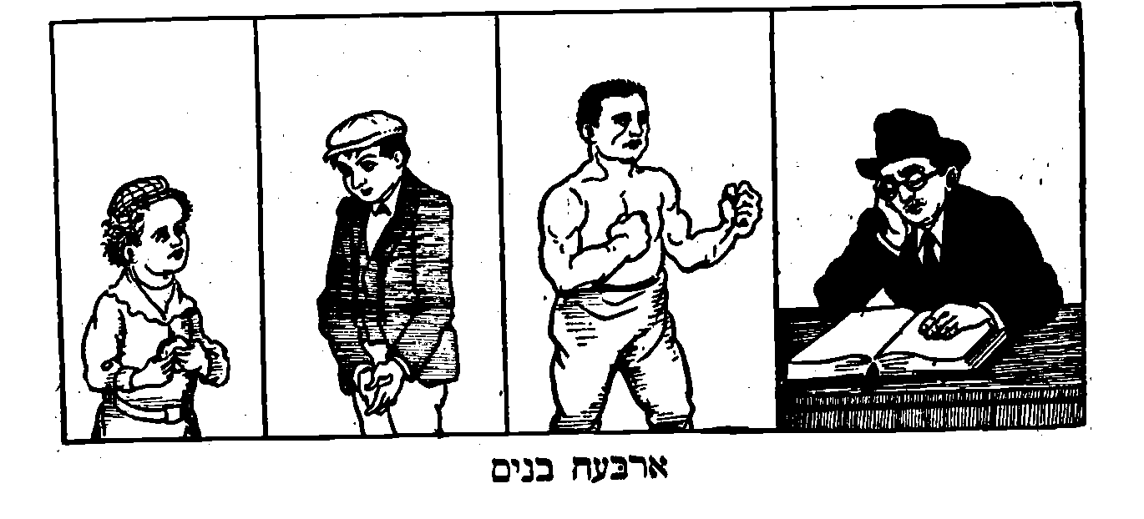
Samuel Field Y Adult Center A Look At The Haggadah
Eisenstein Haggadah 1920-Illustrated by LOLA

Slide 47
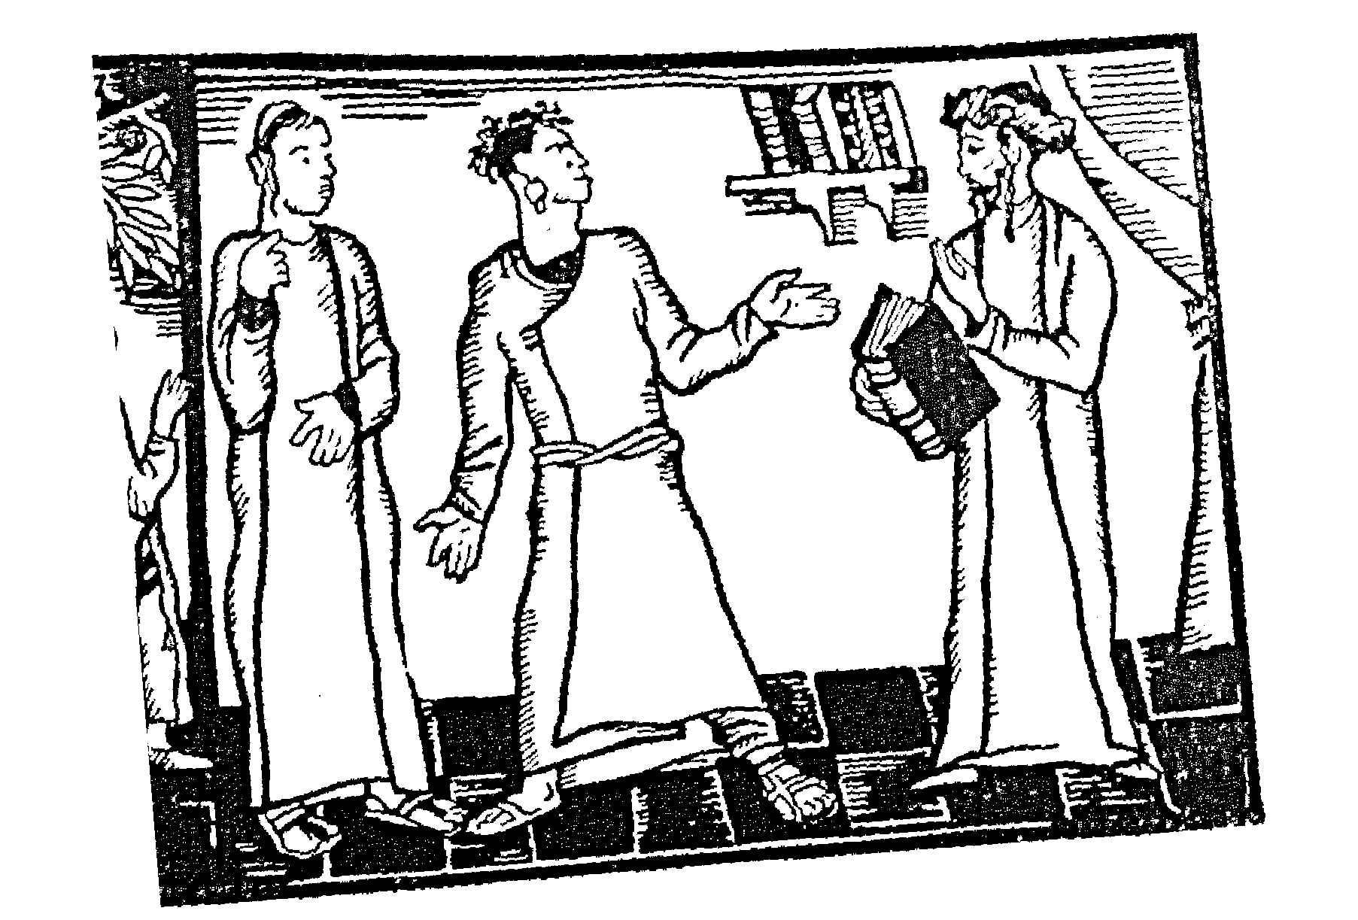
Samuel Field Y Adult Center A Look At The Haggadah
Four Sons Liphshitz-1930

Slide 48
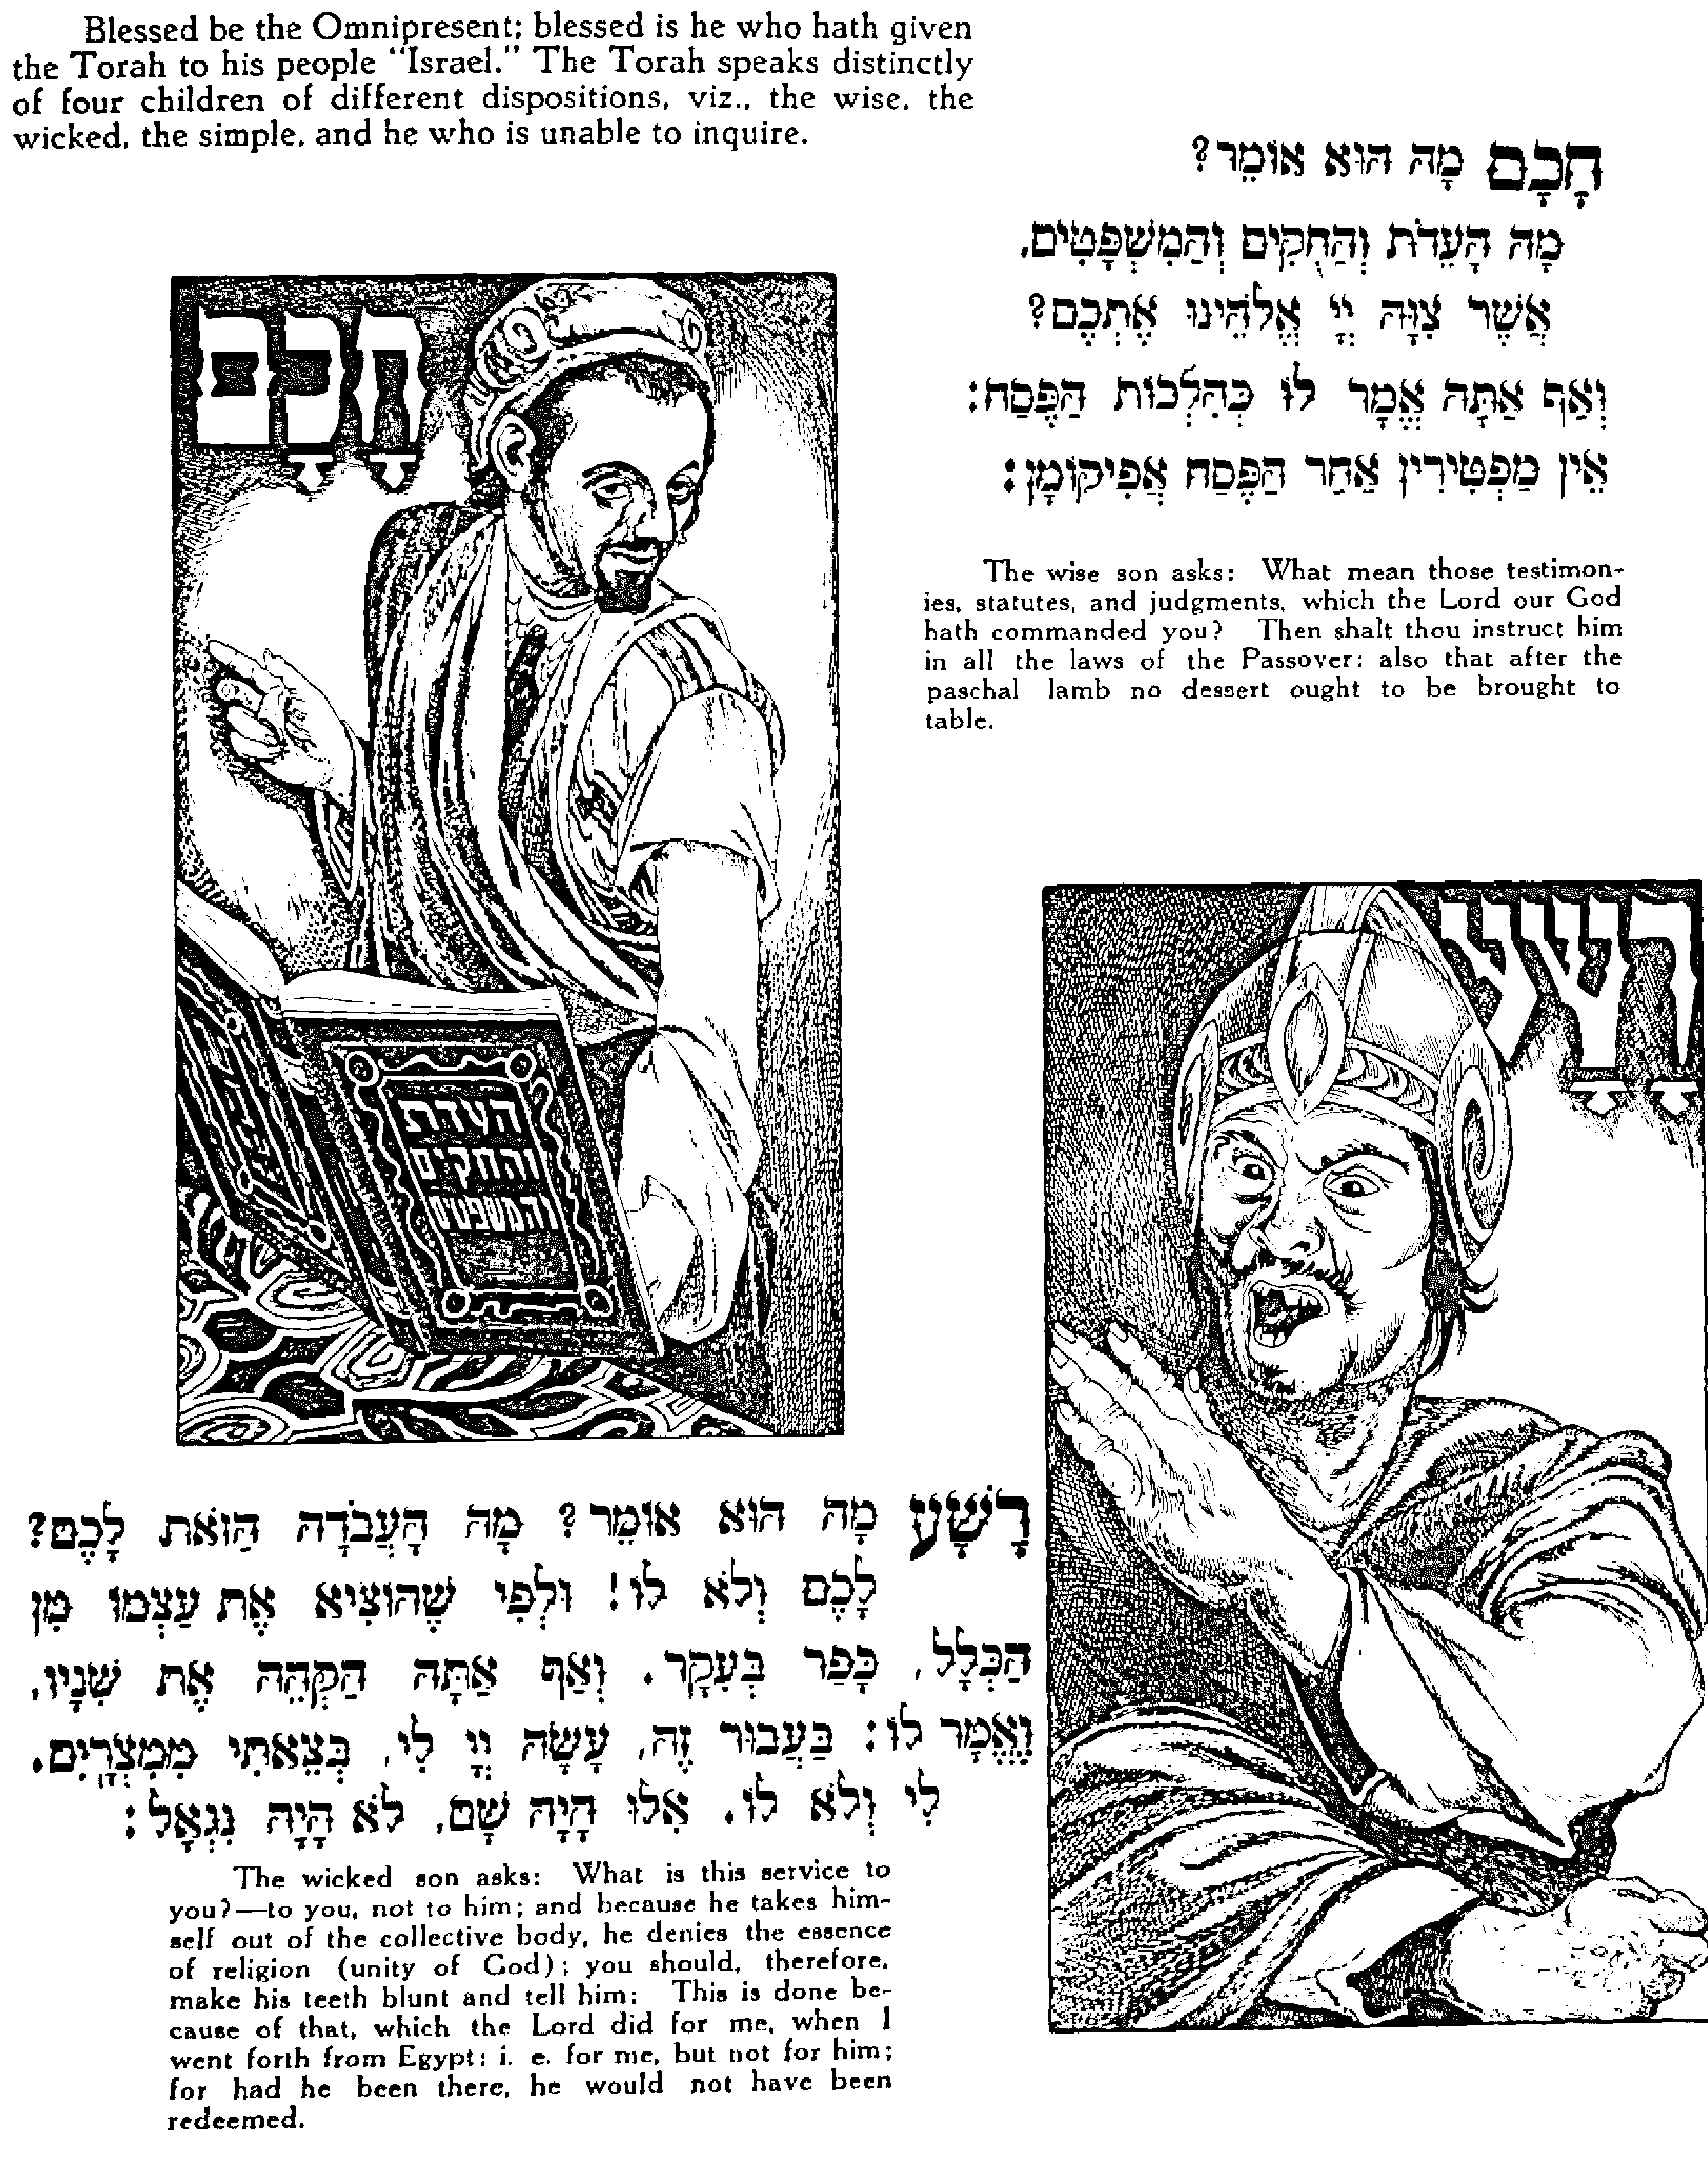
Samuel Field Y Adult Center A Look At The Haggadah
Saul Raskin Haggadah 1941 Four Sons

Slide 49
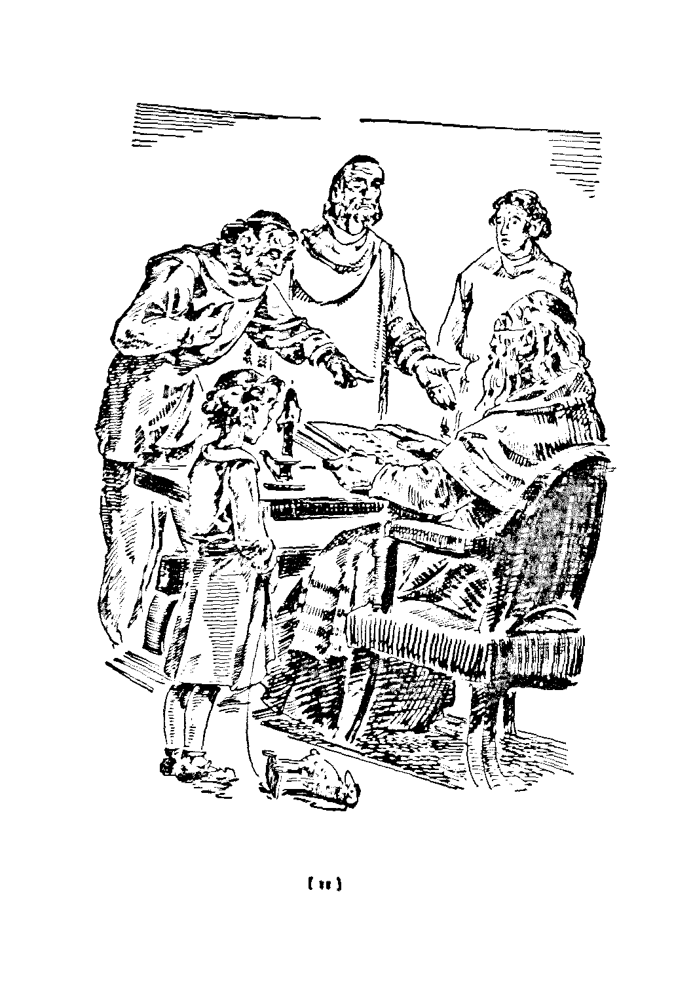
Samuel Field Y Adult Center A Look At The Haggadah
Four Sons America 1942

Slide 50
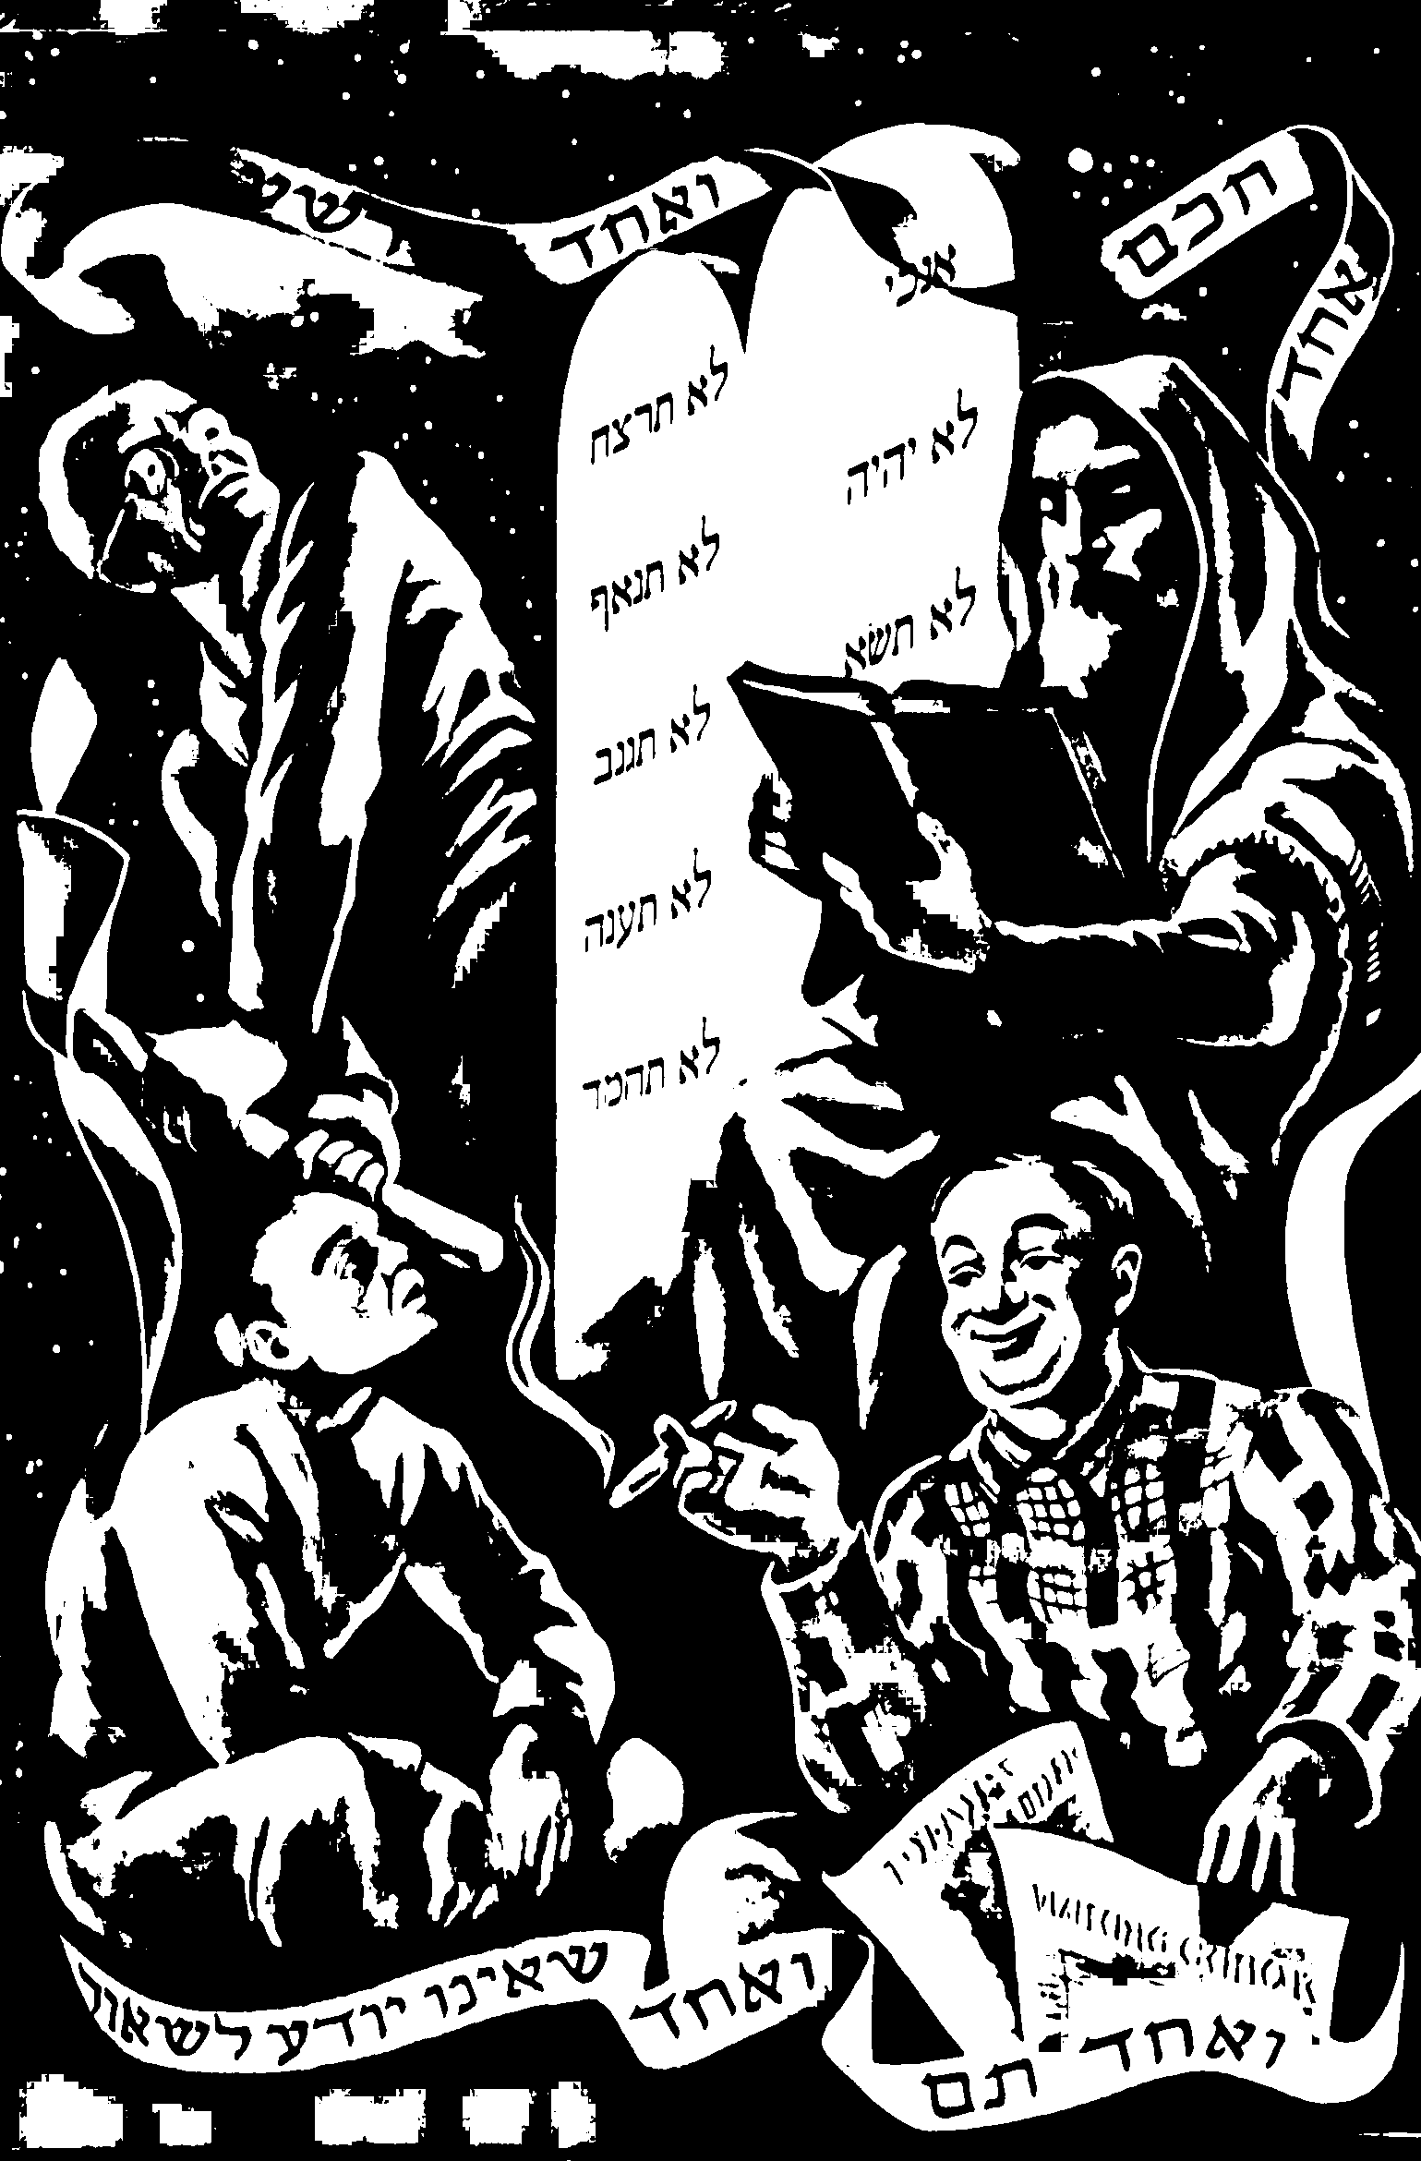
Samuel Field Y Adult Center A Look At The Haggadah
Regelson Haggadah 1949

Slide 51
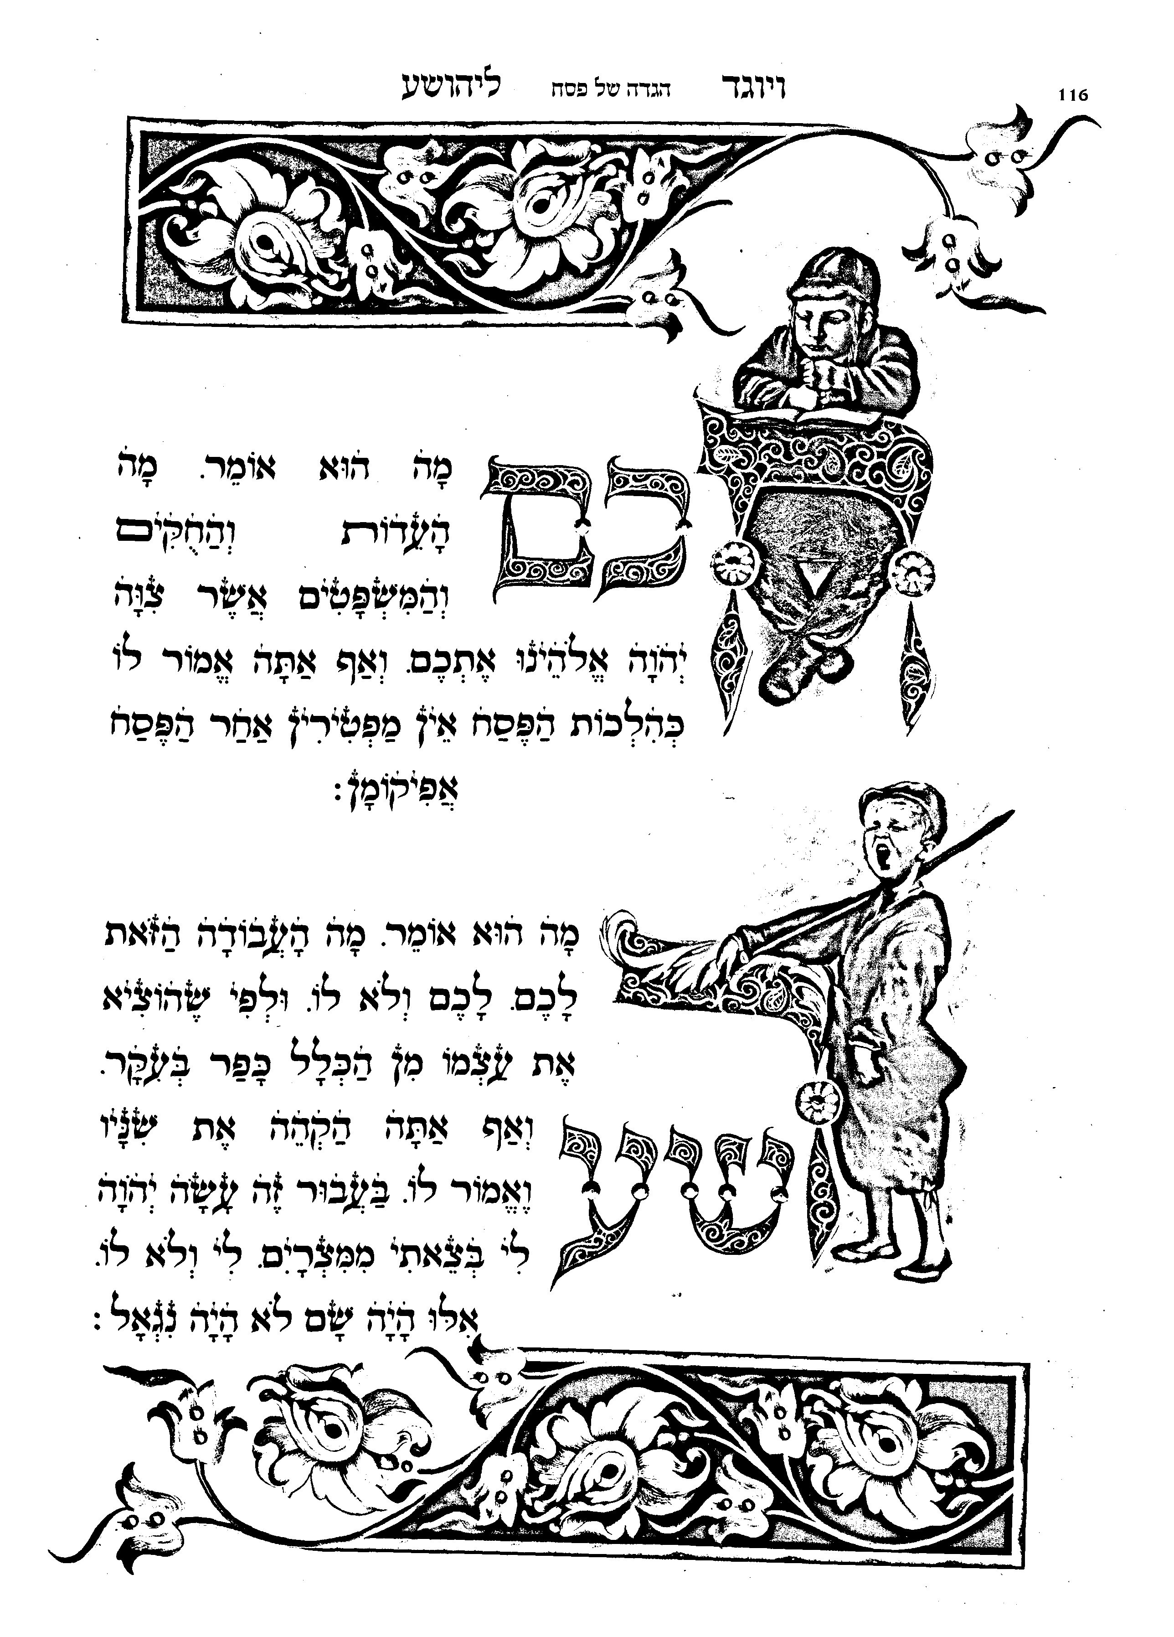
Samuel Field Y Adult Center A Look At The Haggadah
Sephardic Modern

Slide 52
Samuel Field Y Adult Center A Look At The Haggadah
Haggadot Sponsored
By Companies
And Schools

Slide 53
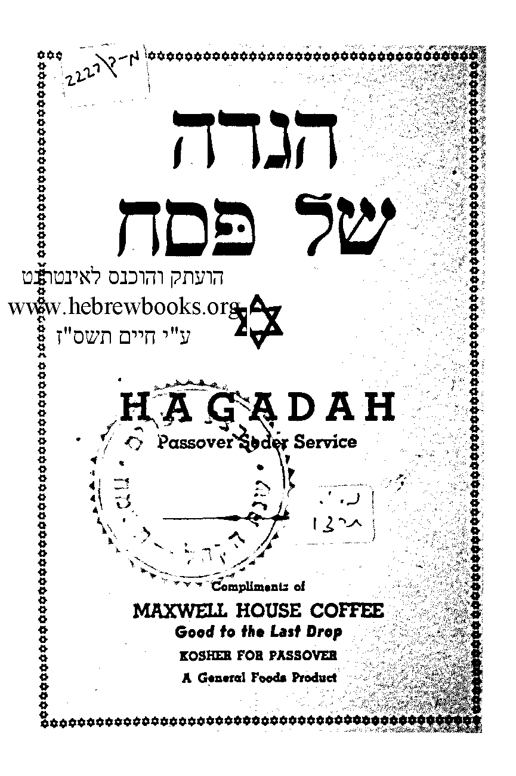
Samuel Field Y Adult Center A Look At The Haggadah
1937

Slide 54
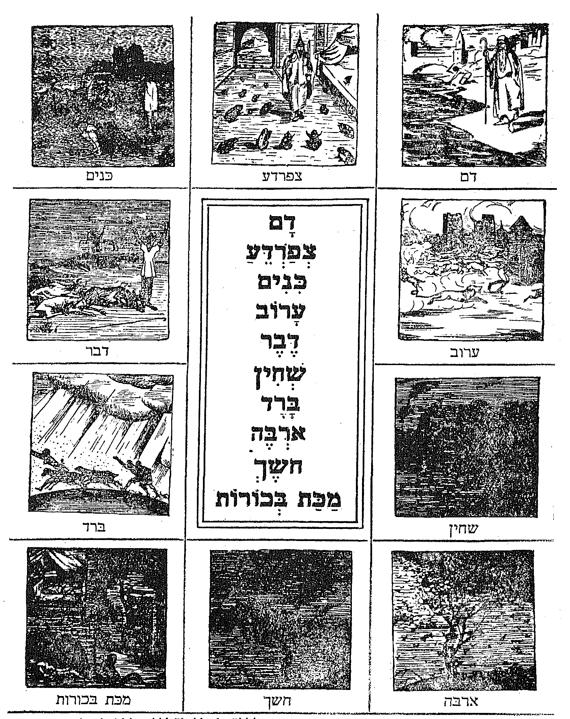
Samuel Field Y Adult Center A Look At The Haggadah
School Haggadah

Slide 55
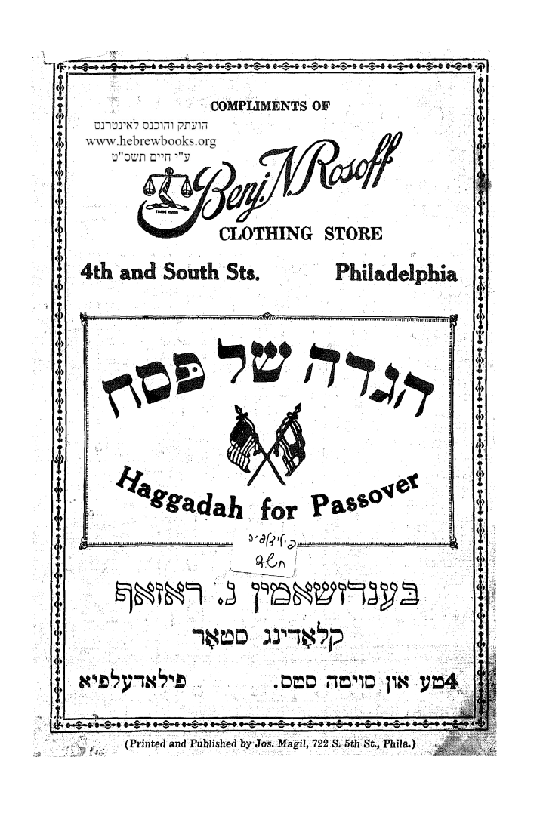
Samuel Field Y Adult Center A Look At The Haggadah
Commercial Haggadah

Slide 56
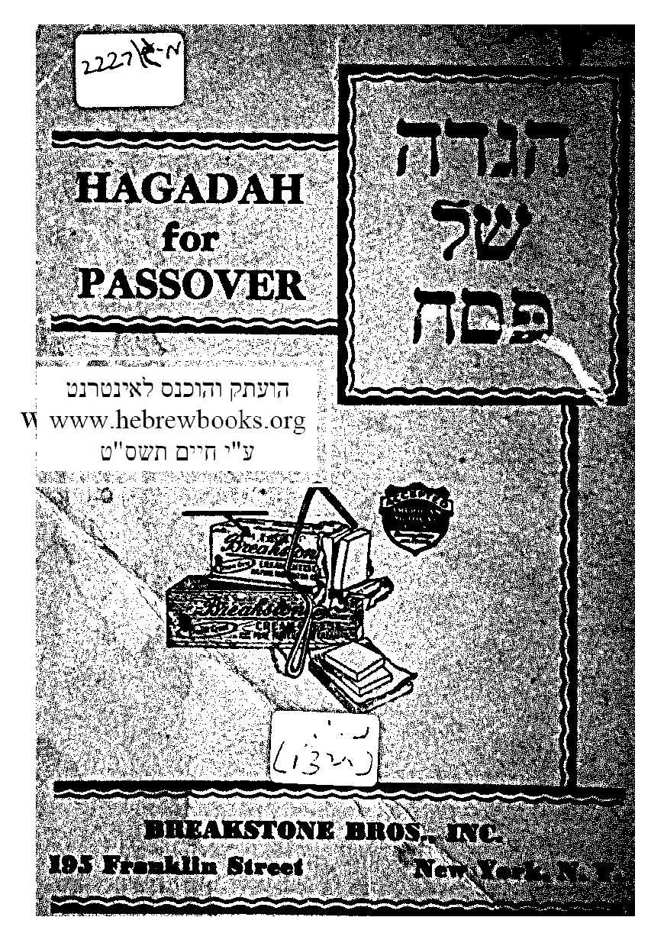
Samuel Field Y Adult Center A Look At The Haggadah
Breakstone Haggadah

Slide 57
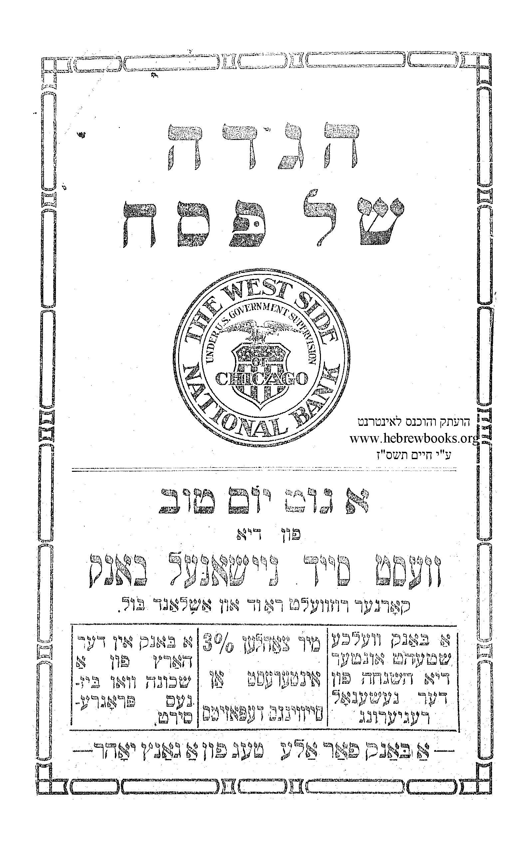
Samuel Field Y Adult Center A Look At The Haggadah
West Side National Bank

